Slide 1



Patterns & Frameworks for Concurrency & Synchronization: Part 1
Douglas C. Schmidt
d.schmidt@vanderbilt.edu
www.dre.vanderbilt.edu/~schmidt
Professor of Computer Science
Institute for Software Integrated Systems Vanderbilt University Nashville, Tennessee, USA

Slide 2
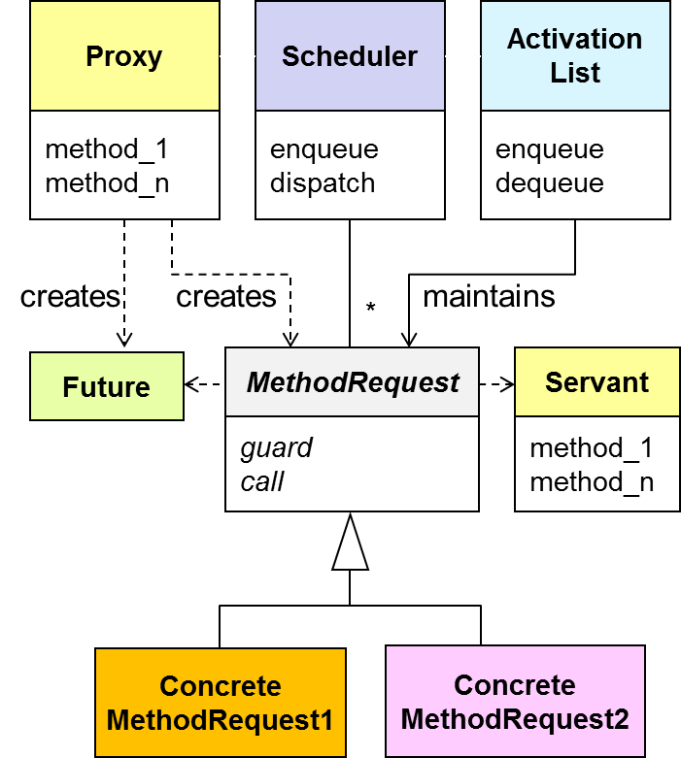
Topics Covered in this Part of the Module
Describe the Active Object pattern

Slide 3


Improving Upon Reactive Event Handling
Context | Problem
High-performance web servers that need to leverage advances in hardware & software | To improve quality-of-service (QoS) for all connected clients, a web server must not block while waiting for connection flow control to abate & must fully leverage parallelism
HTTP runs over TCP, where flow control ensures that senders don’t produce data faster than slow receivers or congested networks can handle

Slide 4

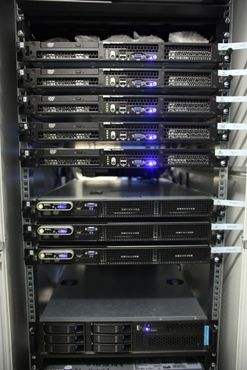
Improving Upon Reactive Event Handling
Context | Problem
High-performance web servers that need to leverage advances in hardware & software | To improve quality-of-service (QoS) for all connected clients, a web server must not block while waiting for connection flow control to abate & must fully leverage parallelism
A web server must also scale efficiently as # of clients grows
Notes:
http://www.flickr.com/photos/akc77/3370167184/sizes/l/

Slide 5
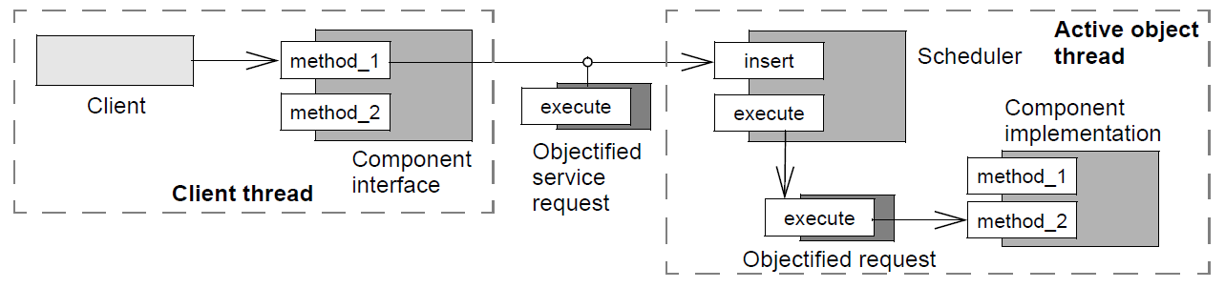
Improving Upon Reactive Event Handling
Context | Problem | Solution
High-performance web servers that need to leverage advances in hardware & software | To improve quality-of-service (QoS) for all connected clients, a web server must not block while waiting for connection flow control to abate & must fully leverage parallelism | Apply the Active Object pattern to scale up server performance by processing each HTTP request concurrently in its own thread
Active Object defines units of concurrency as service requests on components & runs service requests on a component in a different thread from the requesting client thread
Structure
We’ll describe the complete Active Object pattern, but just use a subset of it

Slide 6
Improving Upon Reactive Event Handling
Context | Problem | Solution
High-performance web servers that need to leverage advances in hardware & software | To improve quality-of-service (QoS) for all connected clients, a web server must not block while waiting for connection flow control to abate & must fully leverage parallelism | Apply the Active Object pattern to scale up server performance by processing each HTTP request concurrently in its own thread
Active Object defines units of concurrency as service requests on components & runs service requests on a component in a different thread from the requesting client thread
Structure

Slide 7
Improving Upon Reactive Event Handling
Context | Problem | Solution
High-performance web servers that need to leverage advances in hardware & software | To improve quality-of-service (QoS) for all connected clients, a web server must not block while waiting for connection flow control to abate & must fully leverage parallelism | Apply the Active Object pattern to scale up server performance by processing each HTTP request concurrently in its own thread
Active Object defines units of concurrency as service requests on components & runs service requests on a component in a different thread from the requesting client thread
Structure

Slide 8
Improving Upon Reactive Event Handling
Context | Problem | Solution
High-performance web servers that need to leverage advances in hardware & software | To improve quality-of-service (QoS) for all connected clients, a web server must not block while waiting for connection flow control to abate & must fully leverage parallelism | Apply the Active Object pattern to scale up server performance by processing each HTTP request concurrently in its own thread
Active Object defines units of concurrency as service requests on components & runs service requests on a component in a different thread from the requesting client thread
Structure
See www.dre.vanderbilt.edu/~schmidt/PDF/Active-Objects.pdf for more info

Slide 9
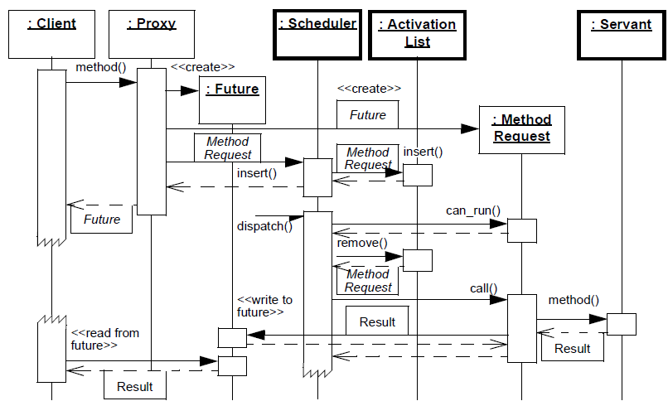
Improving Upon Reactive Event Handling
Context | Problem | Solution
High-performance web servers that need to leverage advances in hardware & software | To improve quality-of-service (QoS) for all connected clients, a web server must not block while waiting for connection flow control to abate & must fully leverage parallelism | Apply the Active Object pattern to scale up server performance by processing each HTTP request concurrently in its own thread
Dynamics
Client invokes a method call on a proxy

Slide 10
Improving Upon Reactive Event Handling
Context | Problem | Solution
High-performance web servers that need to leverage advances in hardware & software | To improve quality-of-service (QoS) for all connected clients, a web server must not block while waiting for connection flow control to abate & must fully leverage parallelism | Apply the Active Object pattern to scale up server performance by processing each HTTP request concurrently in its own thread
Dynamics
Proxy converts method call into method request, passes to scheduler, & returns future to client

Slide 11
Improving Upon Reactive Event Handling
Context | Problem | Solution
High-performance web servers that need to leverage advances in hardware & software | To improve quality-of-service (QoS) for all connected clients, a web server must not block while waiting for connection flow control to abate & must fully leverage parallelism | Apply the Active Object pattern to scale up server performance by processing each HTTP request concurrently in its own thread
Dynamics
Scheduler enqueues method request

Slide 12
Improving Upon Reactive Event Handling
Context | Problem | Solution
High-performance web servers that need to leverage advances in hardware & software | To improve quality-of-service (QoS) for all connected clients, a web server must not block while waiting for connection flow control to abate & must fully leverage parallelism | Apply the Active Object pattern to scale up server performance by processing each HTTP request concurrently in its own thread
Dynamics
Scheduler dequeues method request at some point & runs it on the servant in a separate thread

Slide 13
Improving Upon Reactive Event Handling
Context | Problem | Solution
High-performance web servers that need to leverage advances in hardware & software | To improve quality-of-service (QoS) for all connected clients, a web server must not block while waiting for connection flow control to abate & must fully leverage parallelism | Apply the Active Object pattern to scale up server performance by processing each HTTP request concurrently in its own thread
Dynamics
Clients can obtain result from futures via polling, or callbacks

Slide 14
Applying the Active Object Pattern in JAWS
One way to apply the Active Object pattern to JAWS requires a minor extension to our reactive Acceptor-Connector-based version
ACE_Event _Handler
ACE_Reactor
*
handle_events()
register_handler()
remove_handler()
dispatches
handle_input()
get_handle()
*
owns
Handle
*
notifies
<<uses>>
handle set
Synchronous
Event Demuxer
ACE_ Acceptor
ACE_Svc
_Handler
handle_input()
get_handle()
handle_input()
get_handle()
select()
HTTP_Svc
_Acceptor
HTTP_Svc
_Handler
handle_input()
get_handle()
handle_input()
get_handle()

Slide 15
Applying the Active Object Pattern in JAWS
One way to apply the Active Object pattern to JAWS requires a minor extension to our reactive Acceptor- Connector-based version
We simply inherit from ACE_Acceptor & ACE_Svc_Handler to create a new subclass TPC_HTTP_Handler that runs as an active object
ACE_Event _Handler
ACE_Reactor
*
handle_events()
register_handler()
remove_handler()
dispatches
handle_input()
get_handle()
*
owns
Handle
*
notifies
<<uses>>
handle set
Synchronous
Event Demuxer
ACE_ Acceptor
ACE_Svc
_Handler
handle_input()
get_handle()
open()
svc()
select()
TPC_HTTP
_Acceptor
TPC_HTTP
_Handler
handle_input()
get_handle()
open()
svc()

Slide 16
Applying the Active Object Pattern in JAWS
One way to apply the Active Object pattern to JAWS requires a minor extension to our reactive Acceptor- Connector-based version
We simply inherit from ACE_Acceptor & ACE_Svc_Handler to create a new subclass TPC_HTTP_Handler that runs as an active object
This active object receives & processes requests from a designated connection
i.e., it implements a “thread-per-connection” concurrency model
ACE_Event _Handler
ACE_Reactor
*
handle_events()
register_handler()
remove_handler()
dispatches
handle_input()
get_handle()
*
owns
Handle
*
notifies
<<uses>>
handle set
Synchronous
Event Demuxer
ACE_ Acceptor
ACE_Svc
_Handler
handle_input()
get_handle()
open()
svc()
select()
TPC_HTTP
_Acceptor
TPC_HTTP
_Handler
handle_input()
get_handle()
open()
svc()
This Active Object variant spans user/kernel boundary & omits futures/servants

Slide 17
Benefits of the Active Object Pattern
Enhances concurrency & simplifies synchronized complexity
Client threads & asynchronous method executions can run concurrently
A scheduler can evaluate synchronization constraints to serialize access to servants

Slide 18
Benefits of the Active Object Pattern
Enhances concurrency & simplifies synchronized complexity
Client threads & asynchronous method executions can run concurrently
A scheduler can evaluate synchronization constraints to serialize access to servants
Transparent leveraging of available parallelism
Multiple active object methods can execute in parallel if supported by the OS/hardware

Slide 19
Benefits of the Active Object Pattern
Enhances concurrency & simplifies synchronized complexity
Client threads & asynchronous method executions can run concurrently
A scheduler can evaluate synchronization constraints to serialize access to servants
Transparent leveraging of available parallelism
Multiple active object methods can execute in parallel if supported by the OS/hardware
Method execution order can differ from method invocation order
Methods invoked asynchronous can be executed according to synchronization constraints defined by guards & scheduling policies

Slide 20
Limitations of the Active Object Pattern
Higher overhead
Depending on how an active object is implemented, context switching, synchronization, & data movement/ copying overhead may occur when invoking, scheduling, & executing active object method calls

Slide 21
Limitations of the Active Object Pattern
Higher overhead
Depending on how an active object is implemented, context switching, synchronization, & data movement/ copying overhead may occur when invoking, scheduling, & executing active object method calls
Complicated debugging
It is harder to debug programs that use concurrency due to non-determinism of the various schedulers
Subsets of Active Object are often used to workaround these limitations

Slide 22
Patterns & Frameworks for Concurrency & Synchronization: Part 2
Douglas C. Schmidt
d.schmidt@vanderbilt.edu
www.dre.vanderbilt.edu/~schmidt
Professor of Computer Science
Institute for Software Integrated Systems Vanderbilt University Nashville, Tennessee, USA

Slide 23
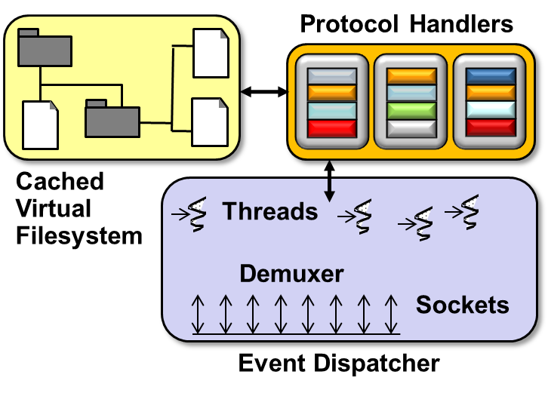
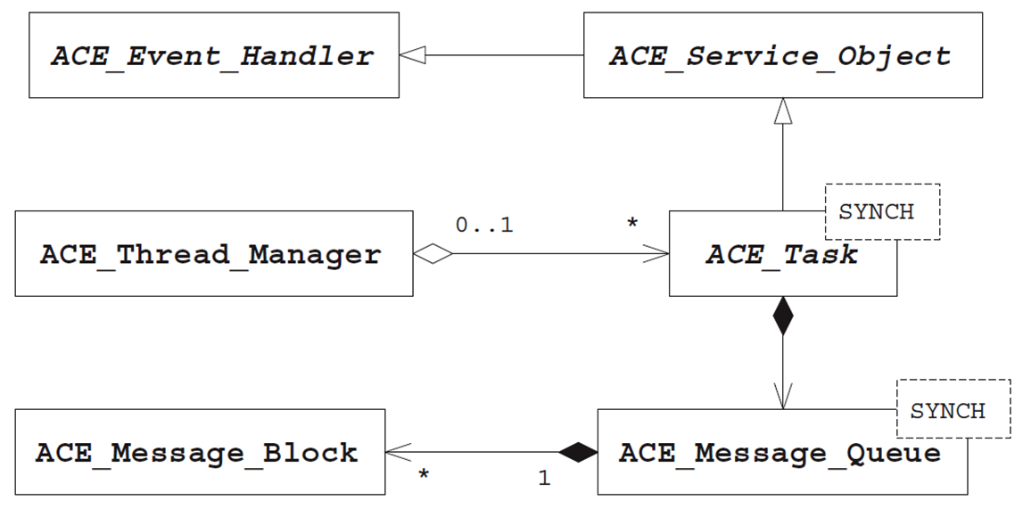
Topics Covered in this Part of the Module
Describe the Active Object pattern
Describe the ACE Task framework

Slide 24
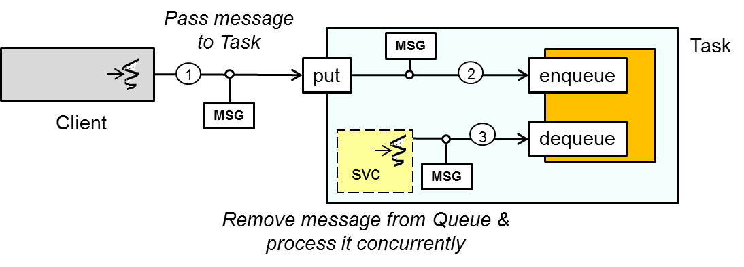
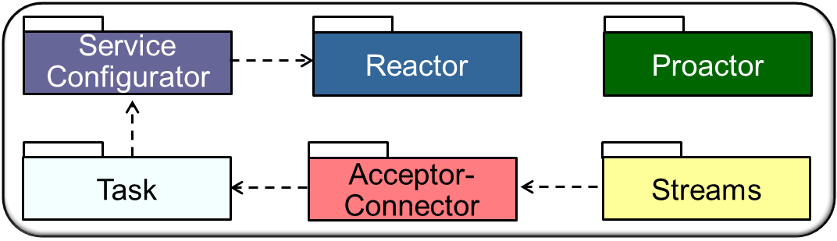
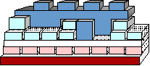
Overview of the ACE Task Framework
Classes in this framework provide a producer/consumer concurrency model that can associate one or more threads with a message queue & other service-related information, such as methods & state

Slide 25
Overview of the ACE Task Framework
Classes in this framework provide a producer/consumer concurrency model that can associate one or more threads with a message queue & other service-related information, such as methods & state
Apps inherit from ACE_Task & override its hook methods, which the ACE Task framework dispatch to decouple invocations from executions
These classes are designed in accordance with the Active Object pattern

Slide 26
Overview of the ACE Task Framework
Classes in this framework provide a producer/consumer concurrency model that can associate one or more threads with a message queue & other service-related information, such as methods & state
Apps inherit from ACE_Task & override its hook methods, which the ACE Task framework dispatch to decouple invocations from executions
Key classes in the ACE Task framework include
ACE Class | Description
ACE_Message_Block | Implements the Composite pattern to enable efficient manipulation of fixed- & variable-sized messages
ACE_Message_Queue | Provides an intra-process message queue that enables applications to pass & buffer messages between threads in a process
ACE_Thread_Manager | Allows applications to portably create & manage the lifetime, synchronization, & properties of one or more threads
ACE_Task | Allows applications to create passive or active objects that decouple different units of processing; use messages to communicate requests, responses, data, & control information; & can queue & process messages sequentially or concurrently

Slide 27
Overview of the ACE Task Framework
Classes in this framework provide a producer/consumer concurrency model that can associate one or more threads with a message queue & other service-related information, such as methods & state
Apps inherit from ACE_Task & override its hook methods, which the ACE Task framework dispatch to decouple invocations from executions
Key classes in the ACE Task framework include
ACE Class | Description
ACE_Message_Block | Implements the Composite pattern to enable efficient manipulation of fixed- & variable-sized messages
ACE_Message_Queue | Provides an intra-process message queue that enables applications to pass & buffer messages between threads in a process
ACE_Thread_Manager | Allows applications to portably create & manage the lifetime, synchronization, & properties of one or more threads
ACE_Task | Allows applications to create passive or active objects that decouple different units of processing; use messages to communicate requests, responses, data, & control information; & can queue & process messages sequentially or concurrently

Slide 28
Overview of the ACE Task Framework
Classes in this framework provide a producer/consumer concurrency model that can associate one or more threads with a message queue & other service-related information, such as methods & state
Apps inherit from ACE_Task & override its hook methods, which the ACE Task framework dispatch to decouple invocations from executions
Key classes in the ACE Task framework include
ACE Class | Description
ACE_Message_Block | Implements the Composite pattern to enable efficient manipulation of fixed- & variable-sized messages
ACE_Message_Queue | Provides an intra-process message queue that enables applications to pass & buffer messages between threads in a process
ACE_Thread_Manager | Allows applications to portably create & manage the lifetime, synchronization, & properties of one or more threads
ACE_Task | Allows applications to create passive or active objects that decouple different units of processing; use messages to communicate requests, responses, data, & control information; & can queue & process messages sequentially or concurrently

Slide 29
Overview of the ACE Task Framework
Classes in this framework provide a producer/consumer concurrency model that can associate one or more threads with a message queue & other service-related information, such as methods & state
Apps inherit from ACE_Task & override its hook methods, which the ACE Task framework dispatch to decouple invocations from executions
Key classes in the ACE Task framework include
ACE Class | Description
ACE_Message_Block | Implements the Composite pattern to enable efficient manipulation of fixed- & variable-sized messages
ACE_Message_Queue | Provides an intra-process message queue that enables applications to pass & buffer messages between threads in a process
ACE_Thread_Manager | Allows applications to portably create & manage the lifetime, synchronization, & properties of one or more threads
ACE_Task | Allows applications to create passive or active objects that decouple different units of processing; use messages to communicate requests, responses, data, & control information; & can queue & process messages sequentially or concurrently

Slide 30
Overview of the ACE Task Framework
Classes in this framework provide a producer/consumer concurrency model that can associate one or more threads with a message queue & other service-related information, such as methods & state
Apps inherit from ACE_Task & override its hook methods, which the ACE Task framework dispatch to decouple invocations from executions
Key classes in the ACE Task framework include
ACE Class | Description
ACE_Message_Block | Implements the Composite pattern to enable efficient manipulation of fixed- & variable-sized messages
ACE_Message_Queue | Provides an intra-process message queue that enables applications to pass & buffer messages between threads in a process
ACE_Thread_Manager | Allows applications to portably create & manage the lifetime, synchronization, & properties of one or more threads
ACE_Task | Allows applications to create passive or active objects that decouple different units of processing; use messages to communicate requests, responses, data, & control information; & can queue & process messages sequentially or concurrently
See www.dre.vanderbilt.edu/~schmidt/PDF/ACE-concurrency.pdf for more info

Slide 31
The ACE_Task Class
Basis of ACE's OO concurrency framework that provides the following capabilities:
Its message queue can decouple data & requests from when they are processed
ACE_Service_Object
ACE_Message _Queue
SYNCH_STRATEGY
ACE_Task
open()
close()
put()
svc()
activate()
…

Slide 32
The ACE_Task Class
Basis of ACE's OO concurrency framework that provides the following capabilities:
Its message queue can decouple data & requests from when they are processed
Can be activated to run as an active object that processes its queued messages in one or more threads
ACE_Service_Object
ACE_Message _Queue
SYNCH_STRATEGY
ACE_Task
open()
close()
put()
svc()
activate()
…

Slide 33
The ACE_Task Class
Basis of ACE's OO concurrency framework that provides the following capabilities:
Its message queue can decouple data & requests from when they are processed
Can be activated to run as an active object that processes its queued messages in one or more threads
Its hook methods can be overridden for task-specific service execution & message handling
ACE_Service_Object
ACE_Message _Queue
SYNCH_STRATEGY
ACE_Task
open()
close()
put()
svc()
activate()
…
ACE_Task inherits ACE dynamic configuration & event handling framework capabilities from its base classes
Handles variability of concurrency & queueing via a common API

Slide 34
ACE_Task Hook Methods
ACE_Service_Object
Performs app-defined initialization & is called once per instance, often spawns thread(s) by calling activate()
ACE_Message _Queue
SYNCH_STRATEGY
ACE_Task
open()
close()
put()
svc()
activate()
…

Slide 35
ACE_Task Hook Methods
ACE_Service_Object
ACE_Message _Queue
Pass a message into the task, which can be processed at that point or inserted into the queue
SYNCH_STRATEGY
ACE_Task
open()
close()
put()
svc()
activate()
…

Slide 36
ACE_Task Hook Methods
ACE_Service_Object
ACE_Message _Queue
SYNCH_STRATEGY
Called in each spawned thread to process requests from the message queue, from a socket, etc.
ACE_Task
open()
close()
put()
svc()
activate()
…

Slide 37
ACE_Task Hook Methods
ACE_Service_Object
ACE_Message _Queue
Called back in each spawned thread’s context after svc() returns—but before thread exits—to perform any needed cleanup
SYNCH_STRATEGY
ACE_Task
open()
close()
put()
svc()
activate()
…

Slide 38
Activating an ACE_Task
The activate() method converts an ACE_Task into an active object
class TPC_HTTP_Handler
: public ACE_Svc_Handler<ACE_SOCK_Stream, ACE_NULL_SYNCH> {
public:
virtual int open (void *) { return activate (); }
Become an active object & calls the svc() hook method in 1 thread
class TP_HTTP_Task : public ACE_Task<ACE_MT_SYNCH> {
public:
enum { THREAD_POOL_SIZE = 8 };
virtual int open (void *) {
return activate (THR_BOUND, THREAD_POOL_SIZE);
}
Become an active object & calls the svc() hook method in 8 threads

Slide 39
Activating an ACE_Task
The activate() method converts an ACE_Task into an active object
It uses the ACE_Task::svc_run() static method as an adapter function to runs in newly spawned thread(s) of control & provide an execution context for the svc() hook method
ACE_Task_Base::activate()
ACE_Thread_Manager::spawn(&ACE_Task_Base::svc_run, this);
_beginthreadex(0, 0, &ACE_Task_Base::svc_run, this, 0, &threadId);
4. void *ACE_Task_Base::svc_run (ACE_Task_Base *t) {
...
t->svc();
...
}
Runtime thread stack
;

Slide 40
Activating an ACE_Task
The activate() method converts an ACE_Task into an active object
It uses the ACE_Task::svc_run() static method as an adapter function to runs in newly spawned thread(s) of control & provide an execution context for the svc() hook method
The ACE_Task class shields apps from OS-specific concurrency details
e.g., it’s simple to replace _beginthreadex()with pthread_create()
ACE_Task_Base::activate()
ACE_Thread_Manager::spawn(&ACE_Task_Base::svc_run, this);
_beginthreadex(0, 0, &ACE_Task_Base::svc_run, this, 0, &threadId);
4. void *ACE_Task_Base::svc_run (ACE_Task_Base *t) {
...
t->svc();
...
}
Runtime thread stack
;

Slide 41
Summary
The ACE Task framework provides extensible object-oriented concurrency capabilities that can
Spawn thread(s) in the context of an object
Client
Task
put
enqueue
dequeue
svc

Slide 42

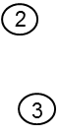
Summary
The ACE Task framework provides extensible object-oriented concurrency capabilities that can
Spawn thread(s) in the context of an object
Transfer & queue messages between objects executing in separate threads
Client
Task
MSG
put
enqueue
MSG
dequeue
svc
MSG

Slide 43
Summary
The ACE Task framework provides extensible object- oriented concurrency capabilities that can
Spawn thread(s) in the context of an object
Transfer & queue messages between objects executing in separate threads
This framework can be applied to implement key concurrency patterns, including
Active Object – which decouples the thread that invokes a method from the thread that executes the method
Client
Task
MSG
put
enqueue
MSG
dequeue
svc
MSG
We’ll show a subset of the complete Active Object pattern shortly

Slide 44
Summary
The ACE Task framework provides extensible object- oriented concurrency capabilities that can
Spawn thread(s) in the context of an object
Transfer & queue messages between objects executing in separate threads
This framework can be applied to implement key concurrency patterns, including
Active Object – which decouples the thread that invokes a method from the thread that executes the method
Half-Sync/Half-Async – which decouples asynchronous & synchronous processing in concurrent systems to simplify programming without unduly reducing performance
Client
Task
MSG
put
enqueue
MSG
dequeue
svc
MSG

Slide 45
Patterns & Frameworks for Concurrency & Synchronization: Part 3
Douglas C. Schmidt
d.schmidt@vanderbilt.edu
www.dre.vanderbilt.edu/~schmidt
Professor of Computer Science
Institute for Software Integrated Systems Vanderbilt University Nashville, Tennessee, USA

Slide 46
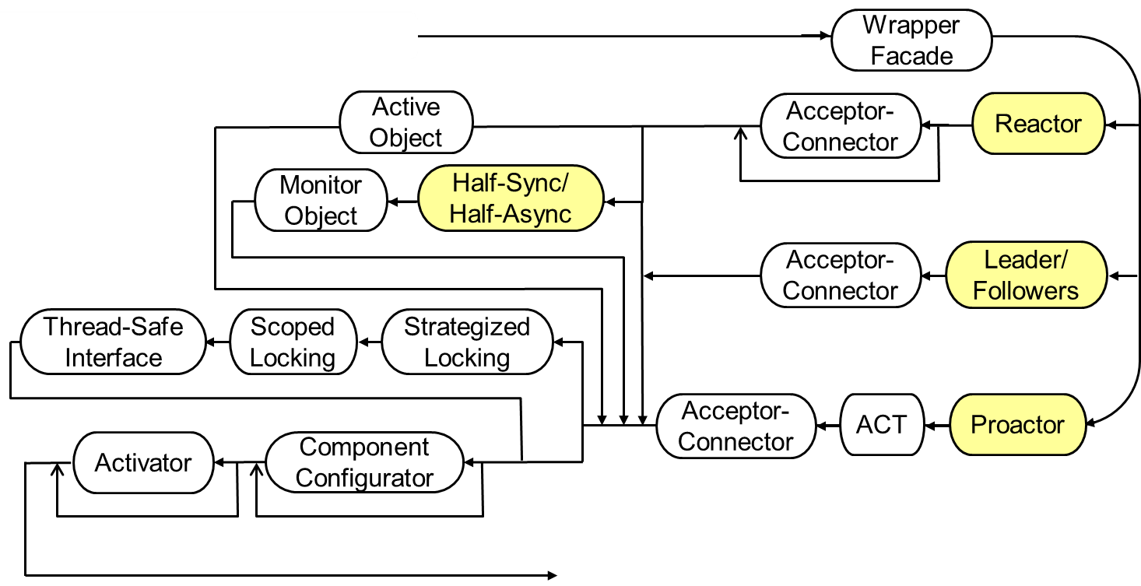
Topics Covered in this Part of the Module
Describe the Active Object pattern
Describe the ACE Task framework
Apply ACE Task & Acceptor-Connector frameworks to JAWS
First multi-threaded path thru JAWS pattern language

Slide 47
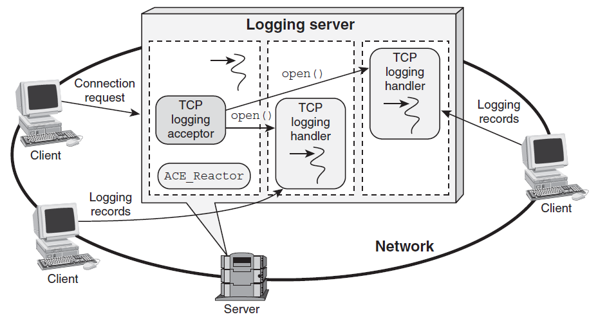



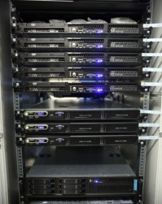
Thread-per-Connection with ACE_Svc_Handler
Use ACE_Svc_Handler (which inherits from ACE_Task) to implement a web server using Active Object pattern & thread-per-connection concurrency model
Web Server
TPC_
HTTP_
Handler
TPC_
HTTP_
Acceptor
TPC_
HTTP_
Handler
GET
request
ACE_Reactor
GET
request

Slide 48
Thread-per-Connection with ACE_Svc_Handler
Be a service handler
class TPC_HTTP_Handler
: public ACE_Svc_Handler<ACE_SOCK_Stream, ACE_NULL_SYNCH> {
public:
virtual int open (void *) { return activate (); }
Hook method called by ACE_Acceptor for each connection

Slide 49
Thread-per-Connection with ACE_Svc_Handler
class TPC_HTTP_Handler
: public ACE_Svc_Handler<ACE_SOCK_Stream, ACE_NULL_SYNCH> {
public:
virtual int open (void *) { return activate (); }
Become an active object & call the svc() hook method

Slide 50
Thread-per-Connection with ACE_Svc_Handler
class TPC_HTTP_Handler
: public ACE_Svc_Handler<ACE_SOCK_Stream, ACE_NULL_SYNCH> {
public:
virtual int open (void *) { return activate (); }
Become an active object & call the svc() hook method
ACE_Task_Base::activate()
ACE_Thread_Manager::spawn(&ACE_Task_Base::svc_run, this);
pthread_create(0, 0, &ACE_Task_Base::svc_run, this)
4. void *ACE_Task_Base::svc_run (ACE_Task_Base *t) {
...
t->svc();
...
}
Runtime thread stack

Slide 51
Thread-per-Connection with ACE_Svc_Handler
class TPC_HTTP_Handler
: public ACE_Svc_Handler<ACE_SOCK_Stream, ACE_NULL_SYNCH> {
public:
virtual int open (void *) { return activate (); }
virtual int svc () {
for (;;) {
std::string pathname (get_pathname (peer ()));
ACE_Mem_Map mapped_file (pathname.c_str ());
switch (peer.send_n (mapped_file.addr (),
mapped_file.size ()) {
case -1: return -1; // Error.
case 0: return 0; // Client closed connection.
default: continue; // Default case.
}
}
return 0; /* NOTREACHED */
}
Runs in a separate thread of control
Memory map requested content
Send the requested content back to client

Slide 52
Thread-per-Connection with ACE_Acceptor
We now show how to use ACE_Acceptor to implement a web server based on the Active Object pattern & thread-per-connection concurrency model
Web Server
TPC_
HTTP_
Acceptor
TPC_
HTTP_
Acceptor
TPC_
HTTP_
Acceptor
GET
request
ACE_Reactor
GET
request

Slide 53
Thread-per-Connection with ACE_Acceptor
Instantiate ACE_Acceptor template
1 typedef ACE_Acceptor<TPC_HTTP_Handler, ACE_SOCK_Acceptor>
2 TPC_HTTP_Acceptor;
3 typedef Reactor_HTTP_Server<TPC_HTTP_Acceptor>
4 HTTP_Server_Daemon;
5 int main (int argc, char *argv[]) {
6 ACE_Reactor reactor;
7 new HTTP_Server_Daemon (argc, argv, &reactor);
8 reactor.run_reactor_event_loop ();
...
Reuse our earlier template driver & Instantiate it with the TPC_HTTP_Acceptor
Event loop controller object
Dynamic allocation ensures proper deletion semantics
Run server event loop
Note the extensive design & code reuse here!

Slide 54
Summary
Only minor changes were required to extend the Reactor & Acceptor-Connector version of the JAWS web server to use Active Object
ACE_Event _Handler
ACE_Reactor
*
handle_events()
register_handler()
remove_handler()
dispatches
handle_input()
get_handle()
*
owns
Handle
*
notifies
<<uses>>
handle set
Synchronous
Event Demuxer
ACE_ Acceptor
ACE_Svc
_Handler
handle_input()
get_handle()
handle_input()
get_handle()
select()
TPC_HTTP
_Acceptor
TPC_HTTP
_Handler
handle_input()
get_handle()
handle_input()
get_handle()
from this…

Slide 55
Summary
Only minor changes were required to extend the Reactor & Acceptor-Connector version of the JAWS web server to use Active Object
ACE_Event _Handler
ACE_Reactor
*
handle_events()
register_handler()
remove_handler()
dispatches
handle_input()
get_handle()
*
owns
Handle
*
notifies
<<uses>>
handle set
Synchronous
Event Demuxer
ACE_ Acceptor
ACE_Svc
_Handler
handle_input()
get_handle()
open()
svc()
select()
TPC_HTTP
_Acceptor
TPC_HTTP
_Handler
handle_input()
get_handle()
open()
svc()
…to this

Slide 56
Summary
Only minor changes were required to extend the Reactor & Acceptor-Connector version of the JAWS web server to use Active Object
The minimal perturbations stems from the variation-oriented design of the ACE frameworks
ACE_Event _Handler
ACE_Reactor
*
handle_events()
register_handler()
remove_handler()
dispatches
handle_input()
get_handle()
*
owns
Handle
*
notifies
<<uses>>
handle set
Synchronous
Event Demuxer
ACE_ Acceptor
ACE_Svc
_Handler
handle_input()
get_handle()
open()
svc()
select()
TPC_HTTP
_Acceptor
TPC_HTTP
_Handler
handle_input()
get_handle()
open()
svc()

Slide 57
Summary
Only minor changes were required to extend the Reactor & Acceptor-Connector version of the JAWS web server to use Active Object
The minimal perturbations stems from the variation-oriented design of the ACE frameworks
As before, very little app code was required since the ACE frameworks took care of the details of
event handling
connection establishment
service initialization
(service configuration)
concurrency
ACE_Event _Handler
ACE_Reactor
*
handle_events()
register_handler()
remove_handler()
dispatches
handle_input()
get_handle()
*
owns
Handle
*
notifies
<<uses>>
handle set
Synchronous
Event Demuxer
ACE_ Acceptor
ACE_Svc
_Handler
handle_input()
get_handle()
open()
svc()
select()
TPC_HTTP
_Acceptor
TPC_HTTP
_Handler
handle_input()
get_handle()
open()
svc()
Generic framework structure & functionality
Specialized app code
There’s still a role for the Reactor pattern, just not in the main data path!

Slide 58
Patterns & Frameworks for Concurrency & Synchronization: Part 4
Douglas C. Schmidt
d.schmidt@vanderbilt.edu
www.dre.vanderbilt.edu/~schmidt
Professor of Computer Science
Institute for Software Integrated Systems Vanderbilt University Nashville, Tennessee, USA

Slide 59
Topics Covered in this Part of the Module
Describe the Active Object pattern
Describe the ACE Task framework
Apply ACE Task & Acceptor-Connector frameworks to JAWS
Describe the Half-Sync/Half-Async pattern
Synchronous
TP_HTTP_Task 1
TP_HTTP_Task 2
TP_HTTP_Task 3
Service Layer
getq()
Queueing
getq()
getq()
Layer
Request Queue
putq()
Asynchronous
TP_HTTP_Handlers & TP_HTTP_Acceptor
Service Layer
<<ready to read>>
ACE_Reactor
Socket Event Sources

Slide 60

Improving Upon Thread-per-Connection
Context | Problem
Web servers that run in settings with large # of clients with bursty request patterns | Allocating an OS thread per connected client doesn’t scale without devoting enormous processing capability & memory to the server(s)

Slide 61
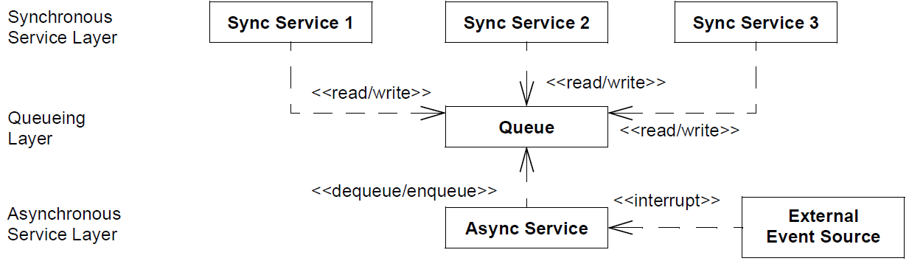
Improving Upon Thread-per-Connection
Context | Problem | Solution
Web servers that run in settings with large # of clients with bursty request patterns | Allocating an OS thread per connected client doesn’t scale without devoting enormous processing capability & memory to the server(s) | Apply the Half-Sync/Half-Async pattern to scale server performance by processing HTTP requests concurrently in multiple threads
The Half-Sync/Half-Async pattern decouples async & sync service processing in concurrent systems, to simplify programming without unduly reducing performance
Structure
This pattern is widely used in operating systems & GUI frameworks

Slide 62
Improving Upon Thread-per-Connection
Context | Problem | Solution
Web servers that run in settings with large # of clients with bursty request patterns | Allocating an OS thread per connected client doesn’t scale without devoting enormous processing capability & memory to the server(s) | Apply the Half-Sync/Half-Async pattern to scale server performance by processing HTTP requests concurrently in multiple threads
The Half-Sync/Half-Async pattern decouples async & sync service processing in concurrent systems, to simplify programming without unduly reducing performance
Structure

Slide 63
Improving Upon Thread-per-Connection
Context | Problem | Solution
Web servers that run in settings with large # of clients with bursty request patterns | Allocating an OS thread per connected client doesn’t scale without devoting enormous processing capability & memory to the server(s) | Apply the Half-Sync/Half-Async pattern to scale server performance by processing HTTP requests concurrently in multiple threads
The Half-Sync/Half-Async pattern decouples async & sync service processing in concurrent systems, to simplify programming without unduly reducing performance
Structure

Slide 64
Improving Upon Thread-per-Connection
Context | Problem | Solution
Web servers that run in settings with large # of clients with bursty request patterns | Allocating an OS thread per connected client doesn’t scale without devoting enormous processing capability & memory to the server(s) | Apply the Half-Sync/Half-Async pattern to scale server performance by processing HTTP requests concurrently in multiple threads
The Half-Sync/Half-Async pattern decouples async & sync service processing in concurrent systems, to simplify programming without unduly reducing performance
Structure
See www.dre.vanderbilt.edu/~schmidt/PDF/HS-HA.pdf for more info

Slide 65
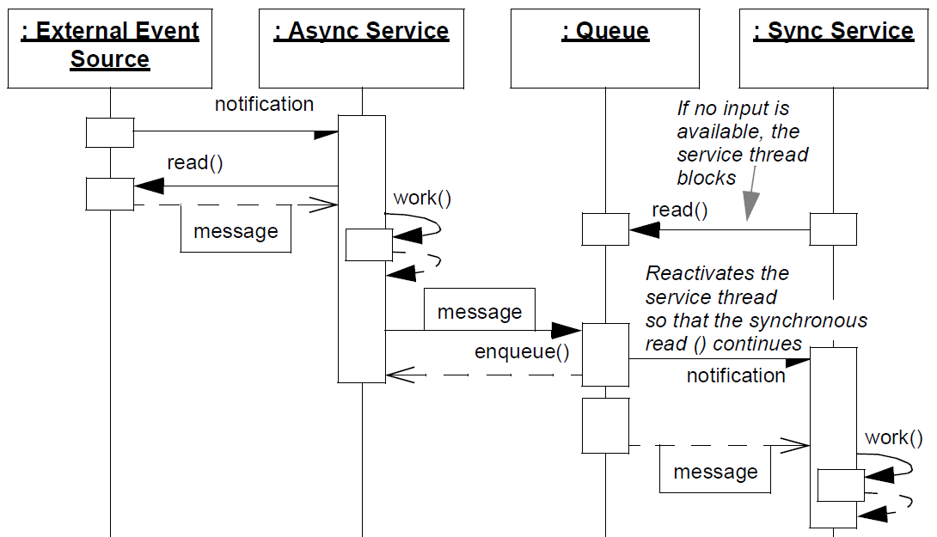
Improving Upon Thread-per-Connection
Context | Problem | Solution
Web servers that run in settings with large # of clients with bursty request patterns | Allocating an OS thread per connected client doesn’t scale without devoting enormous processing capability & memory to the server(s) | Apply the Half-Sync/Half-Async pattern to scale server performance by processing HTTP requests concurrently in multiple threads
Dynamics
Event handling runs reactively/ asynchronously
Sync services run concurrently, relative both to each other & to async services

Slide 66
Improving Upon Thread-per-Connection
Context | Problem | Solution
Web servers that run in settings with large # of clients with bursty request patterns | Allocating an OS thread per connected client doesn’t scale without devoting enormous processing capability & memory to the server(s) | Apply the Half-Sync/Half-Async pattern to scale server performance by processing HTTP requests concurrently in multiple threads
Dynamics
Queue requests without blocking caller
Sync services run concurrently, relative both to each other & to async services

Slide 67
Improving Upon Thread-per-Connection
Context | Problem | Solution
Web servers that run in settings with large # of clients with bursty request patterns | Allocating an OS thread per connected client doesn’t scale without devoting enormous processing capability & memory to the server(s) | Apply the Half-Sync/Half-Async pattern to scale server performance by processing HTTP requests concurrently in multiple threads
Dynamics
Long-duration app processing runs synchronously
Sync services run concurrently, relative both to each other & to async services

Slide 68

Applying Half-Sync/Half-Async Pattern in JAWS
Each thread in the synchronous service layer blocks independently, which prevents a flow-controlled connection from degrading the performance that other clients receive
Synchronous
TP_HTTP_Task 1
TP_HTTP_Task 2
TP_HTTP_Task 3
Service Layer
getq()
Queueing
getq()
getq()
Layer
Request Queue
putq()
Asynchronous
TP_HTTP_Handlers & TP_HTTP_Acceptor
Service Layer
<<ready to read>>
ACE_Reactor
Socket Event Sources
A bounded number of threads can be mapped to separate CPUs/cores to scale up server performance via concurrency

Slide 69
Applying Half-Sync/Half-Async Pattern in JAWS
JAWS can implement the Half-Sync/Half-Async pattern by combining the Reactor pattern with the Active Object pattern
Synchronous
TP_HTTP_Task 1
TP_HTTP_Task 2
TP_HTTP_Task 3
Service Layer
getq()
Queueing
getq()
getq()
Layer
Request Queue
putq()
Asynchronous
TP_HTTP_Handlers & TP_HTTP_Acceptor
Service Layer
<<ready to read>>
ACE_Reactor
Socket Event Sources
The Reactor processes HTTP GET requests asynchronously/ reactively from multiple clients & put them into the request queue

Slide 70
Applying Half-Sync/Half-Async Pattern in JAWS
JAWS can implement the Half-Sync/Half-Async pattern by combining the Reactor pattern with the Active Object pattern
Synchronous
TP_HTTP_Task 1
TP_HTTP_Task 2
TP_HTTP_Task 3
Service Layer
getq()
Queueing
getq()
getq()
Layer
Request Queue
putq()
Asynchronous
TP_HTTP_Handlers & TP_HTTP_Acceptor
Service Layer
<<ready to read>>
ACE_Reactor
Socket Event Sources
Active Object runs a pool of worker threads that remove requests, performs HTTP processing synchronously, & then transfers file back to client

Slide 71
Applying Half-Sync/Half-Async Pattern in JAWS
JAWS can implement the Half-Sync/Half-Async pattern by combining the Reactor pattern with the Active Object pattern
Synchronous
TP_HTTP_Task 1
TP_HTTP_Task 2
TP_HTTP_Task 3
Service Layer
getq()
Queueing
getq()
getq()
Layer
Request Queue
putq()
Asynchronous
TP_HTTP_Handlers & TP_HTTP_Acceptor
Service Layer
<<ready to read>>
ACE_Reactor
Socket Event Sources
A synchronized request queue mediates access between the sync & async layers

Slide 72
Applying Half-Sync/Half-Async Pattern in JAWS
JAWS can implement the Half-Sync/Half-Async pattern by combining the Reactor pattern with the Active Object pattern
Synchronous
TP_HTTP_Task 1
TP_HTTP_Task 2
TP_HTTP_Task 3
Service Layer
getq()
Queueing
getq()
getq()
Layer
Request Queue
putq()
Asynchronous
TP_HTTP_Handlers & TP_HTTP_Acceptor
Service Layer
<<ready to read>>
ACE_Reactor
Socket Event Sources
If flow control occurs on a client connection each thread can block without degrading the QoS of other clients in the thread pool

Slide 73
Benefits of the Half-Sync/Half-Async Pattern
Simplification & performance
The programming of higher-level synchronous processing services are simplified without degrading the performance of lower-level system services
TP_HTTP_Task 1
TP_HTTP_Task 3
TP_HTTP_Task 2
getq()
getq()
getq()
Request Queue
putq()
TP_HTTP_Handlers & TP_HTTP_Acceptor
ACE_Reactor

Slide 74
Benefits of the Half-Sync/Half-Async Pattern
Simplification & performance
The programming of higher-level synchronous processing services are simplified without degrading the performance of lower-level system services
Separation of concerns
Synchronization policies in each layer are decoupled so that each layer need not use the same concurrency strategies
TP_HTTP_Task 1
TP_HTTP_Task 3
TP_HTTP_Task 2
getq()
getq()
getq()
Request Queue
putq()
TP_HTTP_Handlers & TP_HTTP_Acceptor
ACE_Reactor

Slide 75
Benefits of the Half-Sync/Half-Async Pattern
Simplification & performance
The programming of higher-level synchronous processing services are simplified without degrading the performance of lower-level system services
Separation of concerns
Synchronization policies in each layer are decoupled so that each layer need not use the same concurrency strategies
Centralization of inter-layer communication
Inter-layer communication is centralized at a single access point, because all interaction is mediated by the queueing layer
TP_HTTP_Task 1
TP_HTTP_Task 3
TP_HTTP_Task 2
getq()
getq()
getq()
Request Queue
putq()
TP_HTTP_Handlers & TP_HTTP_Acceptor
ACE_Reactor

Slide 76
Limitations of the Half-Sync/Half-Async Pattern
May incur a boundary-crossing penalty
Arising from context switching, synchronization, & data copying overhead when data transferred between sync & async service layers via queueing layer
TP_HTTP_Task 1
TP_HTTP_Task 3
TP_HTTP_Task 2
getq()
getq()
getq()
Request Queue
putq()
TP_HTTP_Handlers & TP_HTTP_Acceptor
ACE_Reactor

Slide 77
Limitations of the Half-Sync/Half-Async Pattern
May incur a boundary-crossing penalty
Arising from context switching, synchronization, & data copying overhead when data transferred between sync & async service layers via queueing layer
Higher-level app services may not benefit from async I/O
Depending on design of OS or application framework interfaces, higher-level services may not use low-level async I/O devices effectively
TP_HTTP_Task 1
TP_HTTP_Task 3
TP_HTTP_Task 2
getq()
getq()
getq()
Request Queue
putq()
TP_HTTP_Handlers & TP_HTTP_Acceptor
ACE_Reactor

Slide 78
Limitations of the Half-Sync/Half-Async Pattern
May incur a boundary-crossing penalty
Arising from context switching, synchronization, & data copying overhead when data transferred between sync & async service layers via queueing layer
Higher-level app services may not benefit from async I/O
Depending on design of OS or application framework interfaces, higher-level services may not use low-level async I/O devices effectively
Complexity of debugging & testing
Apps can be hard to debug due to concurrent execution
TP_HTTP_Task 1
TP_HTTP_Task 3
TP_HTTP_Task 2
getq()
getq()
getq()
Request Queue
putq()
TP_HTTP_Handlers & TP_HTTP_Acceptor
ACE_Reactor

Slide 79
Patterns & Frameworks for Concurrency & Synchronization: Part 5
Douglas C. Schmidt
d.schmidt@vanderbilt.edu
www.dre.vanderbilt.edu/~schmidt
Professor of Computer Science
Institute for Software Integrated Systems Vanderbilt University Nashville, Tennessee, USA

Slide 80
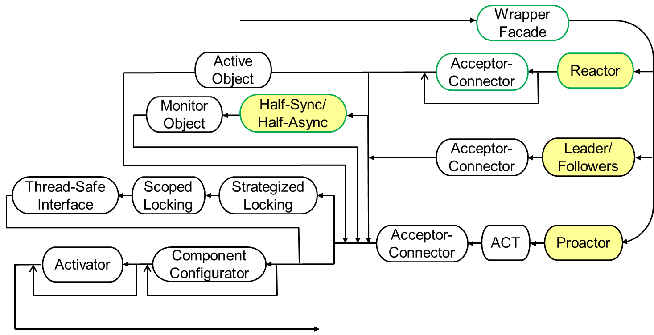
Topics Covered in this Part of the Module
Describe the Active Object pattern
Describe the ACE Task framework
Apply ACE Task & Acceptor-Connector frameworks to JAWS
Describe the Half-Sync/Half-Async pattern
Implement Half-Sync/Half-Async using ACE frameworks
A more scalable multi-threaded path thru the JAWS pattern language

Slide 81
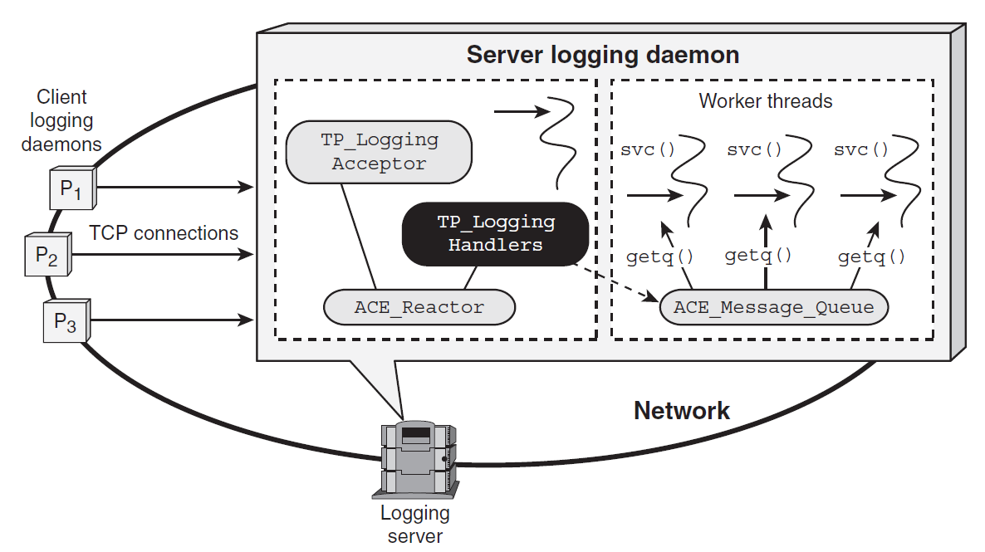
Half-Async with ACE_Svc_Handler Class
Use ACE_Svc_Handler to implement “half-async” portion of JAWS web server based on the Half-Sync/Half-Async pattern
Web Server
Clients
TP_HTTP_Task
TP_HTTP
_Acceptor
TP_HTTP
_Handler
GET
Requests
put()
ACE_Reactor
ACE_Message_Queue
Reactor-based portion of JAWS web server
Server
This implementation is the most complex we’ve seen thus far

Slide 82
Half-Async w/ACE_Svc_Handler Class
Be an ACE_Svc_Handler
class TP_HTTP_Handler
: public ACE_Svc_Handler<ACE_SOCK_Stream, ACE_NULL_SYNCH> {
private:
TP_HTTP_Task &tp_http_task_;
public:
TP_HTTP_Handler (TP_HTTP_Task &task): tp_http_task_ (task) {}
Reference to active object
Activation hook method called by ACE_Acceptor for each connection
Register with reactor to handle input events
virtual int open (void *) {
reactor()->register_handler (this,
ACE_Event_Handler::READ_MASK);
reactor ()->schedule_timer
(this, 0, ACE_Time_Value (CLIENT_TIMEOUT));
}
Register timeout, in case a client sends no HTTP request(s)

Slide 83
Half-Async w/ACE_Svc_Handler Class
Method called back by Reactor when clients timeout to remove the handler & conserve resources
virtual int handle_timeout(const ACE_Time_Value&,const void*){
reactor ()->remove_handler (this,
ACE_Event_Handler::READ_MASK);
}
virtual int handle_input (ACE_HANDLE) {
ACE_Message_Block *msg = 0;
if (recv_request (msg) == HTTP_REQUEST_COMPLETE) {
reactor ()->remove_handler (this,
ACE_Event_Handler::READ_MASK);
reactor ()->cancel_timer (this);
tp_http_task_.put (msg, timeout_);
}
// ...
}
Reactor dispatches this method when HTTP requests arrive
Try to receive complete message
Cleanup resources & pass message to active object for subsequent processing
83

Slide 84
Half-Sync with ACE_Task Class
Use ACE_Task to implement “half-sync” portion of JAWS web server based on the Half-Sync/Half-Async pattern
Web Server
Clients
TP_HTTP_Task
TP_HTTP
_Acceptor
TP_HTTP
_Handler
GET
Requests
put()
ACE_Reactor
ACE_Message_Queue
Server
Active Object-based portion of JAWS web server

Slide 85
Half-Sync with ACE_Task Class
Be an ACE_Task with multi-threaded synchronization trait
class TP_HTTP_Task : public ACE_Task<ACE_MT_SYNCH> {
public:
enum { THREAD_POOL_SIZE = 8 };
TP_HTTP_Task () {
activate (THR_BOUND, THREAD_POOL_SIZE);
}
virtual int put (ACE_Message_Block *message,
ACE_Time_Value *timeout) {
return putq (message, timeout);
}
... // Continued on next slide
Become an active object
Hook method called by half-async layer to pass GET request to half-sync layer
Enqueue message for subsequent processing
We’ll explain how the synchronized message queue works in the next part

Slide 86
Half-Sync with ACE_Task Class
This hook method runs in separate thread(s) via ACE Task framework
int svc () {
for (ACE_Message_Block *msg; getq (msg) != -1; ) {
std::string pathname (get_pathname (msg));
ACE_Mem_Map mapped_file (pathname.c_str ());
switch (get_stream(msg).send_n (mapped_file.addr (),
mapped_file.size ()) {
...
}
...
}
This loop blocks until new message arrives from half-async layer
Map file & send the requested web content back to the client
Note how the core web server logic is the same as always

Slide 87
Half-Sync/Half-Async with ACE_Acceptor Class
Be an ACE_Acceptor
class TP_HTTP_Acceptor : public ACE_Acceptor<TP_HTTP_Handler,
ACE_SOCK_Acceptor>
{
public:
TP_HTTP_Acceptor (ACE_SOCK_Acceptor::PEER_ADDR addr):
ACE_Acceptor<TP_HTTP_Handler, ACE_SOCK_Acceptor> (addr) {}
virtual int make_svc_handler (TP_HTTP_Handler &*handler) {
handler = new TP_HTTP_Handler (tp_http_task_);
return 0;
}
private:
TP_HTTP_Task tp_http_task_;
};
Constructor forwards to ACE_Acceptor
Hook method called by handle_input() to create an TP_HTTP_Handler that receives GET requests from clients
Active object (passed by reference)

Slide 88
Driver for Half-Sync/Half-Async Web Server
1 typedef Reactor_HTTP_Server<TP_HTTP_Acceptor>
2 HTTP_Server_Daemon;
3 int main (int argc, char *argv[]) {
4 ACE_Reactor reactor;
5 new HTTP_Server_Daemon (argc, argv, &reactor);
5 reactor.run_reactor_event_loop ();
...
Reuse our earlier template driver & Instantiate it with the TP_HTTP_Acceptor
Event loop controller object
Dynamic allocation ensures proper deletion semantics
Run server event loop
This main program is nearly identical to the thread-per-connection web server

Slide 89
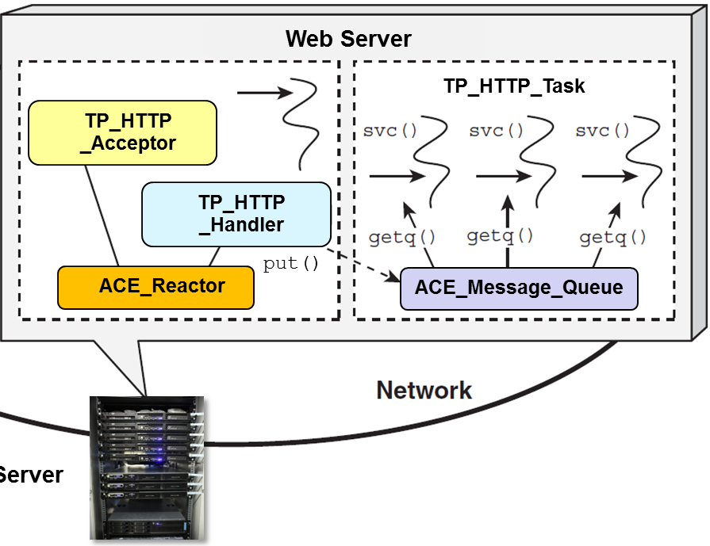
Summary
There are many more “moving parts” in this implementation
Knowledge of patterns & frameworks is essential to keep track of all the parts

Slide 90
Summary
There are many more “moving parts” in this implementation
Knowledge of patterns & frameworks is essential to keep track of all the parts
The Half-Sync/Half-Async implementation of JAWS combines the Reactor & Active Object patterns
Active Object-based portion of JAWS web server
Reactor-based portion of JAWS web server

Slide 91
Summary
There are many more “moving parts” in this implementation
Knowledge of patterns & frameworks is essential to keep track of all the parts
The Half-Sync/Half-Async implementation of JAWS combines the Reactor & Active Object patterns
Likewise, it combines the ACE Reactor, Acceptor-Connector, & Task frameworks
ACE Task-based portion of JAWS web server
ACE Reactor & Acceptor-Connection-based portion of JAWS web server

Slide 92
Summary
There are many more “moving parts” in this implementation
Knowledge of patterns & frameworks is essential to keep track of all the parts
The Half-Sync/Half-Async implementation of JAWS combines the Reactor & Active Object patterns
Likewise, it combines the ACE Reactor, Acceptor-Connector, & Task frameworks
This pattern-oriented software architecture may scale better to multi-core & multi-CPU platforms
e.g., by bounding the number of threads to match the available parallel processing resources more effectively

Slide 93
Patterns & Frameworks for Concurrency & Synchronization: Part 6
Douglas C. Schmidt
d.schmidt@vanderbilt.edu
www.dre.vanderbilt.edu/~schmidt
Professor of Computer Science
Institute for Software Integrated Systems Vanderbilt University Nashville, Tennessee, USA

Slide 94
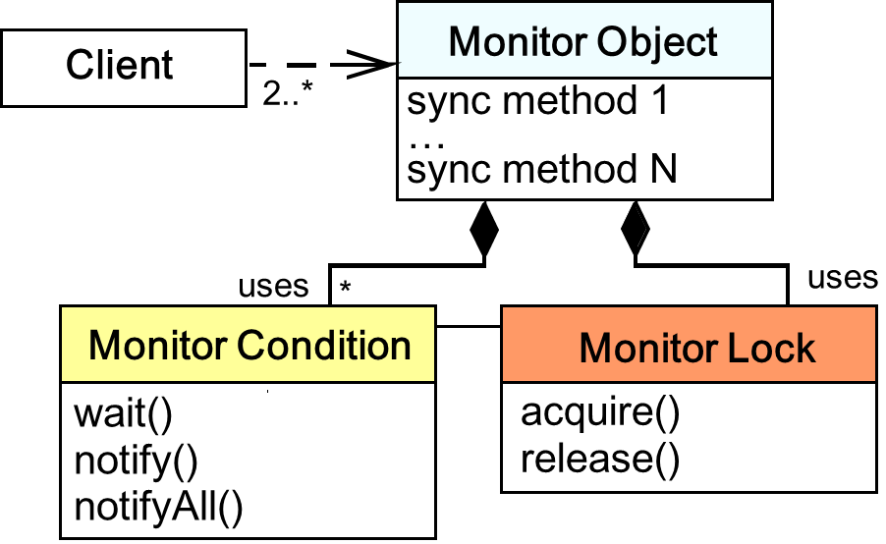
Topics Covered in this Part of the Module
Describe the Active Object pattern
Describe the ACE Task framework
Apply ACE Task & Acceptor-Connector frameworks to JAWS
Describe the Half-Sync/Half-Async pattern
Implement Half-Sync/Half-Async using ACE frameworks
Describe the Monitor Object pattern

Slide 95
Implementing a Synchronized Request Queue
Context | Problem
JAWS’s ACE_Task for Half-Sync/Half-Async contains a request queue | Naïve request queues incurs race conditions or “busy waiting” when multiple threads put/get requests
TP_HTTP_Task 1
TP_HTTP_Task 2
TP_HTTP_Task 3
getq()
getq()
getq()
Request Queue
putq()
TP_HTTP_Handlers & TP_HTTP_Acceptor
Concurrent threads can corrupt the queue’s internal state if it is not synchronized properly
These threads will ‘busy wait’ when the queue is empty or full, which wastes CPU cycles unnecessarily
ACE_Reactor

Slide 96
Implementing a Synchronized Request Queue
Context | Problem | Solution
JAWS’s ACE_Task for Half-Sync/Half-Async contains a request queue | Naïve request queues incurs race conditions or “busy waiting” when multiple threads put/get requests | Apply the Monitor Object pattern to synchronize the request queue efficiently & conveniently
Structure
Monitor Object synchronizes concurrent method execution to ensure only one method at a time runs within an object & allows an object’s methods to cooperatively schedule their execution sequences

Slide 97
Implementing a Synchronized Request Queue
Context | Problem | Solution
JAWS’s ACE_Task for Half-Sync/Half-Async contains a request queue | Naïve request queues incurs race conditions or “busy waiting” when multiple threads put/get requests | Apply the Monitor Object pattern to synchronize the request queue efficiently & conveniently
Structure
Monitor Object synchronizes concurrent method execution to ensure only one method at a time runs within an object & allows an object’s methods to cooperatively schedule their execution sequences

Slide 98
Implementing a Synchronized Request Queue
Context | Problem | Solution
JAWS’s ACE_Task for Half-Sync/Half-Async contains a request queue | Naïve request queues incurs race conditions or “busy waiting” when multiple threads put/get requests | Apply the Monitor Object pattern to synchronize the request queue efficiently & conveniently
Structure
Monitor Object synchronizes concurrent method execution to ensure only one method at a time runs within an object & allows an object’s methods to cooperatively schedule their execution sequences

Slide 99
Implementing a Synchronized Request Queue
Context | Problem | Solution
JAWS’s ACE_Task for Half-Sync/Half-Async contains a request queue | Naïve request queues incurs race conditions or “busy waiting” when multiple threads put/get requests | Apply the Monitor Object pattern to synchronize the request queue efficiently & conveniently
Structure
Monitor Object synchronizes concurrent method execution to ensure only one method at a time runs within an object & allows an object’s methods to cooperatively schedule their execution sequences
See www.dre.vanderbilt.edu/~schmidt/PDF/monitor.pdf for more info

Slide 100
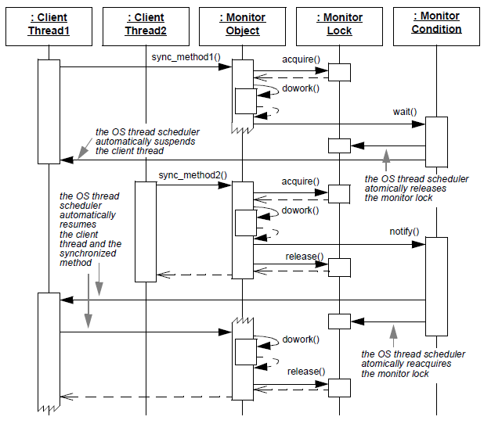
Implementing a Synchronized Request Queue
Context | Problem | Solution
JAWS’s ACE_Task for Half-Sync/Half-Async contains a request queue | Naïve request queues incurs race conditions or “busy waiting” when multiple threads put/get requests | Apply the Monitor Object pattern to synchronize the request queue efficiently & conveniently
Dynamics
Synchronized method invocation & serialization

Slide 101
Implementing a Synchronized Request Queue
Context | Problem | Solution
JAWS’s ACE_Task for Half-Sync/Half-Async contains a request queue | Naïve request queues incurs race conditions or “busy waiting” when multiple threads put/get requests | Apply the Monitor Object pattern to synchronize the request queue efficiently & conveniently
Dynamics
Synchronized method thread suspension

Slide 102
Implementing a Synchronized Request Queue
Context | Problem | Solution
JAWS’s ACE_Task for Half-Sync/Half-Async contains a request queue | Naïve request queues incurs race conditions or “busy waiting” when multiple threads put/get requests | Apply the Monitor Object pattern to synchronize the request queue efficiently & conveniently
Dynamics
Monitor condition notification

Slide 103
Implementing a Synchronized Request Queue
Context | Problem | Solution
JAWS’s ACE_Task for Half-Sync/Half-Async contains a request queue | Naïve request queues incurs race conditions or “busy waiting” when multiple threads put/get requests | Apply the Monitor Object pattern to synchronize the request queue efficiently & conveniently
Dynamics
Synchronized method thread resumption

Slide 104
Applying Monitor Object Pattern in JAWS
ACE_Task
TP_HTTP _Handler
put() putq()
getq()
TP_HTTP
_Task
put()
getq()
TP_HTTP
_Task
TP_HTTP
_Task
TP_HTTP
_Task
ACE_Message_Queue
<<uses>>
2
<<uses>>
ACE_Thread_Condition
ACE_Thread_Mutex
wait()
signal()
broadcast()
acquire()
release()
Uses ACE_Message_Queue & implements the queue’s not_empty_ & not_full_ monitor conditions via ACE wrapper facades

Slide 105
Applying Monitor Object Pattern in JAWS
ACE_Task
TP_HTTP _Handler
put() putq()
getq()
TP_HTTP
_Task
put()
getq()
TP_HTTP
_Task
TP_HTTP
_Task
TP_HTTP
_Task
ACE_Message_Queue
<<uses>>
2
<<uses>>
ACE_Thread_Condition
ACE_Thread_Mutex
wait()
signal()
broadcast()
acquire()
release()
Producer thread remains blocked until the queue is no longer full
Consumer threads remain blocked until the queue is no longer empty
It’s instructive to compare Monitor Object pattern with Active Object pattern

Slide 106
Benefits of the Monitor Object Pattern
Simplification of concurrency control
This pattern presents a concise programming model for sharing an object among cooperating threads where object synchronization corresponds to method invocations

Slide 107
Benefits of the Monitor Object Pattern
Simplification of concurrency control
This pattern presents a concise programming model for sharing an object among cooperating threads where object synchronization corresponds to method invocations
Simplification of scheduling method execution
Synchronized methods use their monitor conditions to determine the circumstances under which they should suspend or resume their execution & that of collaborating monitor objects

Slide 108
Limitations of the Monitor Object Pattern
Limited Scalability
A single monitor lock can limit scalability due to increased contention when multiple threads serialize on a monitor object

Slide 109
Limitations of the Monitor Object Pattern
Limited Scalability
A single monitor lock can limit scalability due to increased contention when multiple threads serialize on a monitor object
Complicated extensibility semantics
These result from the coupling between a monitor object’s functionality & its synchronization mechanisms

Slide 110
Limitations of the Monitor Object Pattern
Limited Scalability
A single monitor lock can limit scalability due to increased contention when multiple threads serialize on a monitor object
Complicated extensibility semantics
These result from the coupling between a monitor object’s functionality & its synchronization mechanisms
Nested monitor lockout
This problem can occur when a monitor object is nested within another monitor object
www.dre.vanderbilt.edu/~schmidt/C++2java.html

Slide 111
Patterns & Frameworks for Concurrency & Synchronization: Part 7
Douglas C. Schmidt
d.schmidt@vanderbilt.edu
www.dre.vanderbilt.edu/~schmidt
Professor of Computer Science
Institute for Software Integrated Systems Vanderbilt University Nashville, Tennessee, USA

Slide 112
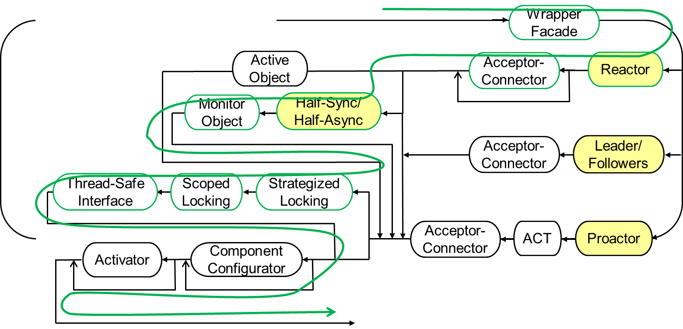
Topics Covered in this Part of the Module
Describe the Active Object pattern
Describe the ACE Task framework
Apply ACE Task & Acceptor-Connector frameworks to JAWS
Describe the Half-Sync/Half-Async pattern
Implement Half-Sync/Half-Async using ACE frameworks
Describe the Monitor Object pattern
Applying Monitor Object & other synchronization patterns
Another scalable multi-threaded path thru the JAWS pattern language

Slide 113
Motivation for the ACE_Message_Queue Class
When producer & consumer tasks are collocated in the same process, tasks often exchange messages via intra-process message queues
Producer task(s) insert messages into a synchronized message queue serviced by consumer task(s) that remove & process the messages
Producer Task
MSG
put
enqueue
dequeue
svc
MSG
MSG
Consumer Task
MSG
put
enqueue
dequeue
svc
MSG

Slide 114
Motivation for the ACE_Message_Queue Class
When producer & consumer tasks are collocated in the same process, tasks often exchange messages via intra-process message queues
Producer task(s) insert messages into a synchronized message queue serviced by consumer task(s) that remove & process the messages
If the queue is full, producers can either block or wait a bounded amount of time to insert their messages
Likewise, if the queue is empty, consumers can either block or wait a bounded amount of time to remove messages
Producer Task
MSG
put
enqueue
dequeue
svc
MSG
MSG
Consumer Task
MSG
put
enqueue
dequeue
svc
MSG

Slide 115
The ACE_Message_Block Class
ACE_Data _Block
Provides means to manipulate messages efficiently via the following capabilities:
Contains a pointer to a ref-counted ACE_Data_Block that points to the actual data associated with a message
Allows chaining of multiple messages together into a composite message
1
*
ACE_Message_Block
cont_ : ACE_Message_Block *
next_ : ACE_Message_Block *
prev_ : ACE_Message_Block *
rd_ptr_ : size_t
wr_ptr_ : size_t
...
duplicate()
release()
copy()
rd_ptr()
wr_ptr()
length() ...

Slide 116
The ACE_Message_Block Class
ACE_Data _Block
Provides means to manipulate messages efficiently via the following capabilities:
Contains a pointer to a ref-counted ACE_Data_Block that points to the actual data associated with a message
Allows chaining of multiple messages together into a composite message
Multiple messages can also be joined together to form doubly-linked list for ACE_Message_Queue
1
*
ACE_Message_Block
cont_ : ACE_Message_Block *
next_ : ACE_Message_Block *
prev_ : ACE_Message_Block *
rd_ptr_ : size_t
wr_ptr_ : size_t
...
duplicate()
release()
copy()
rd_ptr()
wr_ptr()
length() ...

Slide 117
The ACE_Message_Block Class
ACE_Data _Block
Provides means to manipulate messages efficiently via the following capabilities:
Contains a pointer to a ref-counted ACE_Data_Block that points to the actual data associated with a message
Allows chaining of multiple messages together into a composite message
Multiple messages can also be joined together to form doubly-linked list for ACE_Message_Queue
It treats synchronization & memory management properties as aspects
1
*
ACE_Message_Block
cont_ : ACE_Message_Block *
next_ : ACE_Message_Block *
prev_ : ACE_Message_Block *
rd_ptr_ : size_t
wr_ptr_ : size_t
...
duplicate()
release()
copy()
rd_ptr()
wr_ptr()
length() ...
Composite structure minimizes dynamic memory allocation & data copying
Handles variability of message operations via common API

Slide 118
The ACE_Message_Queue Class
This class provides a portable intra-process messaging mechanism that provides the following capabilities:
Messages can be
Enqueued at front or rear of queue, or in priority order
Dequeued from the front or back of the queue
SYNCH_STRATEGY
ACE_Message_Queue
head_ : ACE_Message_Block *
tail_ : ACE_Message_Block *
high_water_mark_ : size_t
low_water_mark_ : size_t
enqueue_head()
enqueue_tail()
enqueue_prio()
dequeue_head()
dequeue_tail()
…

Slide 119
The ACE_Message_Queue Class
This class provides a portable intra-process messaging mechanism that provides the following capabilities:
Messages can be
Enqueued at front or rear of queue, or in priority order
Dequeued from the front or back of the queue
Timeouts can be used to avoid blocking
SYNCH_STRATEGY
ACE_Message_Queue
head_ : ACE_Message_Block *
tail_ : ACE_Message_Block *
high_water_mark_ : size_t
low_water_mark_ : size_t
enqueue_head()
enqueue_tail()
enqueue_prio()
dequeue_head()
dequeue_tail()
…

Slide 120
The ACE_Message_Queue Class
This class provides a portable intra-process messaging mechanism that provides the following capabilities:
Messages can be
Enqueued at front or rear of queue, or in priority order
Dequeued from the front or back of the queue
Timeouts can be used to avoid blocking
It can run in either multi- or single- threaded configurations,
Multi-threaded configuration supports configurable flow control to prevent fast producers from swamping resources of slower consumers
SYNCH_STRATEGY
ACE_Message_Queue
head_ : ACE_Message_Block *
tail_ : ACE_Message_Block *
high_water_mark_ : size_t
low_water_mark_ : size_t
enqueue_head()
enqueue_tail()
enqueue_prio()
dequeue_head()
dequeue_tail()
…
Allocators can be strategized so memory used by messages can be obtained from various sources
Handles variability of queueing synchronization mechanisms via common API

Slide 121
Transparently Parameterizing Synchronization
Context | Problem
The concurrency patterns described earlier impact ACE_ Message_Queue synchronization strategies | Hard-coding synchronization strategies into ACE_Message _Queue implementations is inflexible, but maintaining multiple versions manually is not scalable
class Nonsynch_Message_Queue {
...
protected:
ACE_Message_Block *head_;
ACE_Message_Block *tail_;
...
};
No synchronizers

Slide 122
Transparently Parameterizing Synchronization
Context | Problem
The concurrency patterns described earlier impact ACE_ Message_Queue synchronization strategies | Hard-coding synchronization strategies into ACE_Message _Queue implementations is inflexible, but maintaining multiple versions manually is not scalable
class Nonsynch_Message_Queue {
...
protected:
ACE_Message_Block *head_;
ACE_Message_Block *tail_;
...
};
class Synch_Message_Queue {
...
protected:
ACE_Message_Block *head_;
ACE_Message_Block *tail_;
ACE_Thread_Mutex lock_;
ACE_Condition<ACE_Thread_Mutex> not_empty_;
ACE_Condition<ACE_Thread_Mutex> not_full_;
...
};
Synchronizers

Slide 123
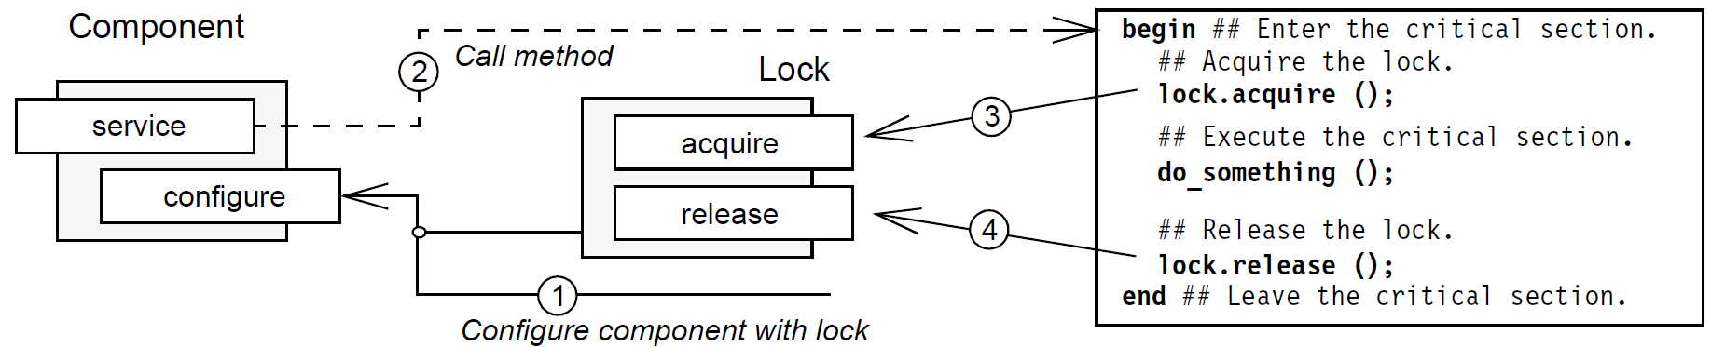
Transparently Parameterizing Synchronization
Context | Problem | Solution
The concurrency patterns described earlier impact ACE_ Message_Queue synchronization strategies | Hard-coding synchronization strategies into ACE_Message _Queue implementations is inflexible, but maintaining multiple versions manually is not scalable | Apply Strategized Locking pattern to parameterize the synchronization mechanisms of ACE_ Message_Queue
Strategized Locking parameterizes synchronization mechanisms that protect a component’s critical sections from concurrent access
See www.dre.vanderbilt.edu/~schmidt/PDF/locking-patterns.pdf for more info

Slide 124
Applying Strategized Locking to ACE_Message_Queue
Strategize the locking mechanisms
template <typename SYNCH_STRATEGY>
class ACE_Message_Queue {
...
protected:
ACE_Message_Block *head_;
ACE_Message_Block *tail_;
typename SYNCH_STRATEGY::MUTEX lock_;
typename SYNCH_STRATEGY::CONDITION not_empty_;
typename SYNCH_STRATEGY::CONDITION not_full_;
...
};
Parameterized locking strategy
Traits that coordinate concurrent access

Slide 125
Applying Strategized Locking to ACE_Message_Queue
Define a family of traits classes that convey information used by ACE_Message_Queue to determine policies at compile time
class ACE_NULL_SYNCH {
public:
typedef ACE_Null_Mutex
MUTEX;
typedef ACE_Null_Condition
CONDITION;
typedef ACE_Null_Semaphore
SEMAPHORE;
...
};
class ACE_MT_SYNCH {
public:
typedef ACE_Thread_Mutex
MUTEX;
typedef ACE_Condition <ACE_Thread_Mutex>
CONDITION;
typedef ACE_Thread_Semaphore
SEMAPHORE;
...
};
No-op synchronizers
Actual synchronizers

Slide 126
Applying Strategized Locking to ACE_Message_Queue
Define a family of traits classes that convey information used by ACE_Message_Queue to determine policies at compile time
Traits classes needn’t derive from a common base class or use virtual methods!
class ACE_NULL_SYNCH {
public:
typedef ACE_Null_Mutex
MUTEX;
typedef ACE_Null_Condition
CONDITION;
typedef ACE_Null_Semaphore
SEMAPHORE;
...
};
class ACE_MT_SYNCH {
public:
typedef ACE_Thread_Mutex
MUTEX;
typedef ACE_Condition <ACE_Thread_Mutex>
CONDITION;
typedef ACE_Thread_Semaphore
SEMAPHORE;
...
};

Slide 127
Applying Strategized Locking to ACE_Message_Queue
Use the traits classes to instantiate ACE_Message_Queue with the desired type of synchronization strategy
No-op synchronizers
typedef ACE_Message_Queue <ACE_NULL_SYNCH>
ST_MQ;
ST_MQ st_mq;
ACE_Message_Block *mb;
...
st_mq.dequeue_head (mb);
Does not block

Slide 128
Applying Strategized Locking to ACE_Message_Queue
Use the traits classes to instantiate ACE_Message_Queue with the desired type of synchronization strategy
Actual synchronizers
typedef ACE_Message_Queue <ACE_NULL_SYNCH>
ST_MQ;
ST_MQ st_mq;
ACE_Message_Block *mb;
...
st_mq.dequeue_head (mb);
typedef ACE_Message_Queue
<ACE_MT_SYNCH>
MT_MQ;
MT_MQ mt_mq;
ACE_Message_Block *mb;
...
mt_mq.dequeue_head (mb);
Does block
It’s also common practice to use dynamic polymorphism to strategize locking

Slide 129
Benefits of the Strategized Locking Pattern
Enhanced flexibility & customization
It is straightforward to configure & customize a component for designated concurrency models because the synchronization aspects of components are strategized

Slide 130
Benefits of the Strategized Locking Pattern
Enhanced flexibility & customization
It is straightforward to configure & customize a component for designated concurrency models because the synchronization aspects of components are strategized
Decreased maintenance effort for components
It is straightforward to add enhancements & bug fixes to a component because there is only one implementation, rather than a separate implementation for each concurrency model

Slide 131
Benefits of the Strategized Locking Pattern
Enhanced flexibility & customization
It is straightforward to configure & customize a component for designated concurrency models because the synchronization aspects of components are strategized
Decreased maintenance effort for components
It is straightforward to add enhancements & bug fixes to a component because there is only one implementation, rather than a separate implementation for each concurrency model
Improved reuse
Components implemented using this pattern are more reusable, because their locking strategies can be configured orthogonally to their behavior

Slide 132
Limitations of the Strategized Locking Pattern
Obtrusive locking
If templates are used to parameterize locking aspects this will expose the locking strategies to application code

Slide 133
Limitations of the Strategized Locking Pattern
Obtrusive locking
If templates are used to parameterize locking aspects this will expose the locking strategies to application code
Over-engineering
Externalizing a locking mechanism by placing it in a component’s interface may actually provide too much flexibility in certain situations
e.g., inexperienced developers may try to parameterize a component with the wrong type of lock, resulting in improper compile-time or runtime behavior

Slide 134
Ensuring Locks are Released Properly
Context | Problem
A shared resource that is concurrently accessed & updated by multiple threads must be protected by a lock | If programmers acquire & release locks explicitly, it’s hard to ensure locks are released in all code paths
template <typename SYNCH_STRATEGY> class ACE_Message_Queue {
public:
...
int dequeue_head (ACE_Message_Block &*mb, ACE_Time_Value *to) {
lock_.acquire ();
...
lock_.release ();
}
...
Control can leave scope in C++ prematurely due to return, break, continue, goto, or unhandled exception

Slide 135
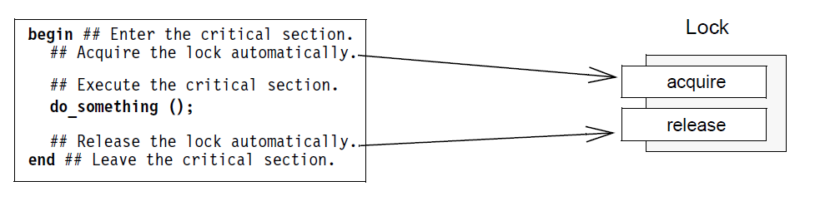
Ensuring Locks are Released Properly
Context | Problem | Solution
A shared resource that is concurrently accessed & updated by multiple threads must be protected by a lock | If programmers acquire & release locks explicitly, it’s hard to ensure locks are released in all code paths | Apply the Scoped Locking pattern to automatically acquire a lock when control enters a scope & automatically release the lock when control leaves the scope
Scoped Locking ensures that entering a critical section becomes thread-safe & leaving the critical section releases all acquired locks
See www.dre.vanderbilt.edu/~schmidt/PDF/locking-patterns.pdf for more info

Slide 136
Applying Scoped Locking to ACE_Message_Queue
Define a guard class that acquires & releases a particular type of lock in its constructor & destructor, respectively
Store a pointer to lock & acquire lock in constructor
template <typename LOCK>
class ACE_Guard {
public:
ACE_Guard (LOCK &lock): lock_ (&lock) { lock_->acquire (); }
~ACE_Guard () { lock_->release (); }
...
private:
LOCK *lock_;
}
Destructor releases lock when guard goes out of scope
Pointer to the lock that’s being managed
ACE_Guard illustrates another benefit of applying the Wrapper Façade pattern

Slide 137
Applying Scoped Locking to ACE_Message_Queue
Let critical sections correspond to the scope & lifetime of a guard object
template <typename SYNCH_STRATEGY> class ACE_Message_Queue {
public:
...
int dequeue_head (ACE_Message_Block *&mb, ACE_Timeout *to) {
ACE_Guard<typename SYNCH_STRATEGY::MUTEX> guard (lock_);
...
}
...
Use Scoped Locking to acquire & release lock_ automatically
lock_ released automatically when guard goes out of scope
Instances of ACE_Guard can be allocated on the run-time stack to acquire & release locks in method or block scopes that define critical sections

Slide 138
Benefit of the Scoped Locking Pattern
Increased robustness
This pattern increases the robustness of concurrent applications by eliminating common programming errors related to synchronization & multi-threading
By applying Scoped Locking, locks are acquired & released automatically when control enters & leaves critical sections defined by C++ method & block scopes
See en.wikipedia.org/wiki/Resource_Acquisition_Is_Initialization for C++ idiom

Slide 139
Limitations of the Scoped Locking Pattern
Potential for deadlock when used recursively
If a method that uses Scoped Locking calls itself recursively, ‘self-deadlock’ will occur if the lock is not a recursive mutex

Slide 140
Limitations of the Scoped Locking Pattern
Potential for deadlock when used recursively
If a method that uses Scoped Locking calls itself recursively, ‘self-deadlock’ will occur if the lock is not a recursive mutex
Limitations with language-specific semantics
Scoped Locking is based on programming language features & thus isn’t integrated with OS-specific system calls
Locks may therefore not be released automatically when threads abort or exit inside a guarded critical section, e.g., via longjmp()

Slide 141
Minimizing Unnecessary Locking
Context | Problem
Components in multi-threaded applications that (1) contain intra-component method calls & (2) have applied Strategized Locking | Thread-safe components should not lock unnecessarily Thread-safe components should be designed to avoid “self-deadlock”
template <typename SYNCH_STRATEGY> class ACE_Message_Queue {
public:
int dequeue_head (ACE_Message_Block *&mb, ACE_Timeout *to) {
ACE_Guard<typename SYNCH_STRATEGY::MUTEX> guard (lock_);
...
while (is_empty()) not_empty_cond_.wait ();
...
int is_empty () {
ACE_Guard<typename SYNCH_STRATEGY::MUTEX> guard (lock_);
return cur_bytes_ == 0 && cur_count_ == 0;
...
Errors and/or overhead may occur depending on type of locking strategy

Slide 142
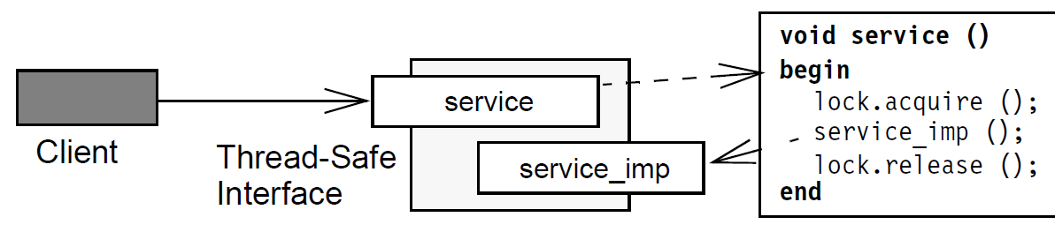
Minimizing Unnecessary Locking
Context | Problem | Solution
Components in multi-threaded applications that (1) contain intra-component method calls & (2) have applied Strategized Locking | Thread-safe components should not lock unnecessarily Thread-safe components should be designed to avoid “self-deadlock” | Apply the Thread-safe Interface pattern to minimize locking overhead & ensure that intra-component method calls don’t incur ‘self-deadlock’
Interface methods check
Implementation methods trust
See www.dre.vanderbilt.edu/~schmidt/PDF/locking-patterns.pdf for more info

Slide 143
Applying Thread-safe Interface to ACE_Message_Queue
Split a component’s methods into publicly accessible interface methods & corresponding private implementation methods
template <typename SYNCH_STRATEGY> class ACE_Message_Queue {
public:
int dequeue_head (ACE_Message_Block *&mb, ACE_Timeout *to) {
ACE_Guard<typename SYNCH_STRATEGY::MUTEX> guard (lock_);
...
while (is_empty_i ()) not_empty_cond_.wait ()
...
private:
int is_empty_i () {
return cur_bytes_ == 0 && cur_count_ == 0;
...
Interface method checks lock is acquired, calls associated implementation method, & automatically releases lock
Implementation method trusts lock is held, does its work, & only invokes other implementation methods
This pattern allows a broader range of locking strategies

Slide 144
Benefits of the Thread-safe Interface Pattern
Increased robustness
This pattern ensures that self-deadlock does not occur due to intra-component method calls

Slide 145
Benefits of the Thread-safe Interface Pattern
Increased robustness
This pattern ensures that self-deadlock does not occur due to intra-component method calls
Enhanced performance
This pattern ensures that locks are not acquired or released unnecessarily

Slide 146
Benefits of the Thread-safe Interface Pattern
Increased robustness
This pattern ensures that self-deadlock does not occur due to intra-component method calls
Enhanced performance
This pattern ensures that locks are not acquired or released unnecessarily
Simplification of software
Separating the locking & functionality concerns can help to simplify both aspects

Slide 147
Limitations of the Thread-safe Interface Pattern
Additional indirection & extra methods
Each interface method requires at least one implementation method
Increases memory footprint & may also add an extra level of indirection

Slide 148
Limitations of the Thread-safe Interface Pattern
Additional indirection & extra methods
Each interface method requires at least one implementation method
Increases memory footprint & may also add an extra level of indirection
Potential for misuse
OO languages support class-level rather than object-level access control
An object can thus bypass the public interface to call a private method on another object of same class, thereby bypassing that object’s lock

Slide 149
Limitations of the Thread-safe Interface Pattern
Additional indirection & extra methods
Each interface method requires at least one implementation method
Increases memory footprint & may also add an extra level of indirection
Potential for misuse
OO languages support class-level rather than object-level access control
An object can thus bypass the public interface to call a private method on another object of same class, thereby bypassing that object’s lock
Potential overhead
This pattern prevents multiple components from sharing the same lock & prevents locking at a finer granularity than the component, which can increase lock contention

Slide 150
Patterns & Frameworks for Concurrency & Synchronization: Part 8
Douglas C. Schmidt
d.schmidt@vanderbilt.edu
www.dre.vanderbilt.edu/~schmidt
Professor of Computer Science
Institute for Software Integrated Systems Vanderbilt University Nashville, Tennessee, USA

Slide 151
Topics Covered in this Part of the Module
Describe the Active Object pattern
Describe the ACE Task framework
Apply ACE Task & Acceptor-Connector frameworks to JAWS
Describe the Half-Sync/Half-Async pattern
Implement Half-Sync/Half-Async using ACE frameworks
Describe the Monitor Object pattern
Applying Monitor Object & other synchronization patterns
Describe the Leader/ Followers pattern
demultiplexes
Thread Pool
synchronizer
join()
promote_new_leader()
*
Event Handler
Handle
uses
handle_event ()
get_handle()
*
Handle Set
handle_events()
deactivate_handle()
reactivate_handle()
select()
Concrete Event Handler B
handle_event ()
get_handle()
Concrete Event Handler A
handle_event ()
get_handle()

Slide 152
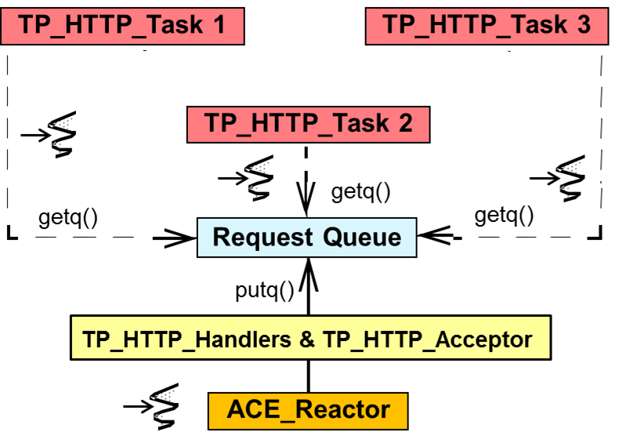
Enhancing Predictability with Leader/Followers
Context | Problem
Web servers that run on multi-core & -CPU platforms | Half-Sync/Half-Async can incur excessive memory management, synchronization, context switching, & data movement overhead in some settings

Slide 153
Enhancing Predictability with Leader/Followers
Context | Problem
Web servers that run on multi-core & -CPU platforms | Half-Sync/Half-Async can incur excessive memory management, synchronization, context switching, & data movement overhead in some settings
Dynamic memory (de)allocation

Slide 154
Enhancing Predictability with Leader/Followers
Context | Problem
Web servers that run on multi-core & -CPU platforms | Half-Sync/Half-Async can incur excessive memory management, synchronization, context switching, & data movement overhead in some settings
Dynamic memory (de)allocation
Synchronization operations

Slide 155
Enhancing Predictability with Leader/Followers
Context | Problem
Web servers that run on multi-core & -CPU platforms | Half-Sync/Half-Async can incur excessive memory management, synchronization, context switching, & data movement overhead in some settings
Dynamic memory (de)allocation
Synchronization operations
Context switches

Slide 156
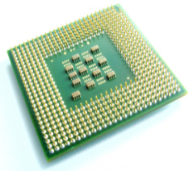
Enhancing Predictability with Leader/Followers
Context | Problem
Web servers that run on multi-core & -CPU platforms | Half-Sync/Half-Async can incur excessive memory management, synchronization, context switching, & data movement overhead in some settings
Dynamic memory (de)allocation
Synchronization operations
Context switches
CPU cache updates

Slide 157
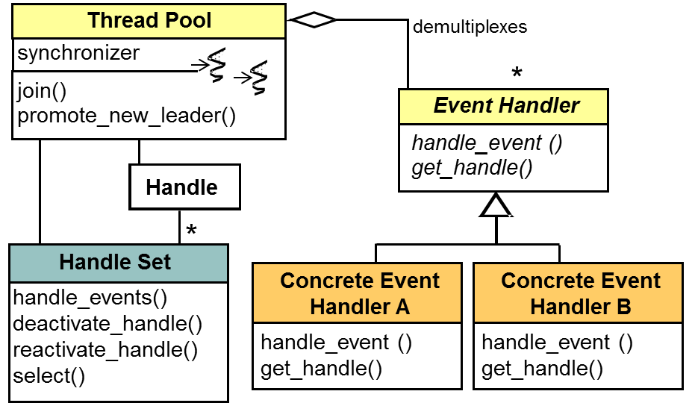
Enhancing Predictability with Leader/Followers
Context | Problem | Solution
Web servers that run on multi-core & -CPU platforms | Half-Sync/Half-Async can incur excessive memory management, synchronization, context switching, & data movement overhead in some settings | Apply the Leader/ Followers pattern to reduce thread pool overhead & jitter
Structure
*
Leader/Follower provides an efficient & predictable concurrency model where multiple threads take turns sharing event sources to process service requests that occur on the event sources

Slide 158
Enhancing Predictability with Leader/Followers
Context | Problem | Solution
Web servers that run on multi-core & -CPU platforms | Half-Sync/Half-Async can incur excessive memory management, synchronization, context switching, & data movement overhead in some settings | Apply the Leader/ Followers pattern to reduce thread pool overhead & jitter
Structure
*
Leader/Follower provides an efficient & predictable concurrency model where multiple threads take turns sharing event sources to process service requests that occur on the event sources

Slide 159
Enhancing Predictability with Leader/Followers
Context | Problem | Solution
Web servers that run on multi-core & -CPU platforms | Half-Sync/Half-Async can incur excessive memory management, synchronization, context switching, & data movement overhead in some settings | Apply the Leader/ Followers pattern to reduce thread pool overhead & jitter
Structure
*
Leader/Follower provides an efficient & predictable concurrency model where multiple threads take turns sharing event sources to process service requests that occur on the event sources

Slide 160
Enhancing Predictability with Leader/Followers
Context | Problem | Solution
Web servers that run on multi-core & -CPU platforms | Half-Sync/Half-Async can incur excessive memory management, synchronization, context switching, & data movement overhead in some settings | Apply the Leader/ Followers pattern to reduce thread pool overhead & jitter
Structure
*
Leader/Follower provides an efficient & predictable concurrency model where multiple threads take turns sharing event sources to process service requests that occur on the event sources

Slide 161
Enhancing Predictability with Leader/Followers
Context | Problem | Solution
Web servers that run on multi-core & -CPU platforms | Half-Sync/Half-Async can incur excessive memory management, synchronization, context switching, & data movement overhead in some settings | Apply the Leader/ Followers pattern to reduce thread pool overhead & jitter
Structure
*
Leader/Follower provides an efficient & predictable concurrency model where multiple threads take turns sharing event sources to process service requests that occur on the event sources
See www.dre.vanderbilt.edu/~schmidt/PDF/LF.pdf for more info on this pattern

Slide 162
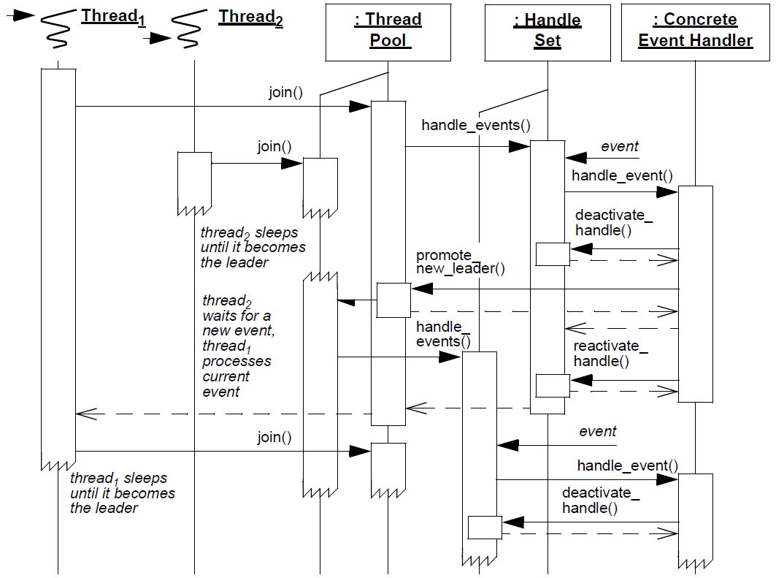
Enhancing Predictability with Leader/Followers
Context | Problem | Solution
Web servers that run on multi-core & -CPU platforms | Half-Sync/Half-Async can incur excessive memory management, synchronization, context switching, & data movement overhead in some settings | Apply the Leader/ Followers pattern to reduce thread pool overhead & jitter
Dynamics
Leader thread demuxing & dispatching

Slide 163
Enhancing Predictability with Leader/Followers
Context | Problem | Solution
Web servers that run on multi-core & -CPU platforms | Half-Sync/Half-Async can incur excessive memory management, synchronization, context switching, & data movement overhead in some settings | Apply the Leader/ Followers pattern to reduce thread pool overhead & jitter
Dynamics
Follower thread promotion

Slide 164
Enhancing Predictability with Leader/Followers
Context | Problem | Solution
Web servers that run on multi-core & -CPU platforms | Half-Sync/Half-Async can incur excessive memory management, synchronization, context switching, & data movement overhead in some settings | Apply the Leader/ Followers pattern to reduce thread pool overhead & jitter
Dynamics
Event processing

Slide 165
Enhancing Predictability with Leader/Followers
Context | Problem | Solution
Web servers that run on multi-core & -CPU platforms | Half-Sync/Half-Async can incur excessive memory management, synchronization, context switching, & data movement overhead in some settings | Apply the Leader/ Followers pattern to reduce thread pool overhead & jitter
Dynamics
Rejoin the thread pool

Slide 166
Applying Leader/Followers Pattern in JAWS
ACE_TP_Reactor eliminates need for—& overhead of—a separate Reactor thread & synchronized request queue used in Half-Sync/Half-Async pattern
demultiplexes
Thread Pool
synchronizer
join()
promote_new_leader()
*
ACE_Event_Handler
*
ACE_Handle
uses
handle_input ()
get_handle()
ACE_TP_Reactor
run_event_loop()
deacitivate_handle()
reactivate_handle()
select()
HTTP_Svc
_Acceptor
HTTP_Svc
_Handler
handle_input ()
get_handle()
handle_input ()
get_handle()

Slide 167
Applying Leader/Followers Pattern in JAWS
ACE_TP_Reactor eliminates need for—& overhead of—a separate Reactor thread & synchronized request queue used in Half-Sync/Half-Async pattern
demultiplexes
Thread Pool
synchronizer
join()
promote_new_leader()
*
ACE_Event_Handler
*
ACE_Handle
uses
handle_input ()
get_handle()
ACE_TP_Reactor
run_event_loop()
deacitivate_handle()
reactivate_handle()
select()
HTTP_Svc
_Acceptor
HTTP_Svc
_Handler
handle_input ()
get_handle()
handle_input ()
get_handle()
Half-Sync/Half-Async design may still be more appropriate for certain types of servers, however, because
It can reorder & prioritize client requests more flexibly via its request queue
It may be more scalable since it queues requests in virtual memory

Slide 168
Benefits of the Leader/Followers Pattern
Performance enhancements
Improves CPU cache affinity & removes need for dynamic memory allocation & data buffer sharing between threads
Thread Pool
demultiplexes
synchronizer
join()
promote_new_leader()
*
Event Handler
Handle
uses
handle_event ()
get_handle()
*
Handle Set
handle_events()
deactivate_handle()
reactivate_handle()
select()
Concrete Event Handler B
handle_event ()
get_handle()
Concrete Event Handler A
handle_event ()
get_handle()

Slide 169
Benefits of the Leader/Followers Pattern
Performance enhancements
Improves CPU cache affinity & removes need for dynamic memory allocation & data buffer sharing between threads
Minimizes locking overhead by not exchanging data between threads, thus reducing thread synchronization
Thread Pool
demultiplexes
synchronizer
join()
promote_new_leader()
*
Event Handler
Handle
uses
handle_event ()
get_handle()
*
Handle Set
handle_events()
deactivate_handle()
reactivate_handle()
select()
Concrete Event Handler B
handle_event ()
get_handle()
Concrete Event Handler A
handle_event ()
get_handle()

Slide 170
Benefits of the Leader/Followers Pattern
Performance enhancements
Improves CPU cache affinity & removes need for dynamic memory allocation & data buffer sharing between threads
Minimizes locking overhead by not exchanging data between threads, thus reducing thread synchronization
Minimizes priority inversion because no extra queueing is used in the server
Thread Pool
demultiplexes
synchronizer
join()
promote_new_leader()
*
Event Handler
Handle
uses
handle_event ()
get_handle()
*
Handle Set
handle_events()
deactivate_handle()
reactivate_handle()
select()
Concrete Event Handler B
handle_event ()
get_handle()
Concrete Event Handler A
handle_event ()
get_handle()

Slide 171
Benefits of the Leader/Followers Pattern
Performance enhancements
Improves CPU cache affinity & removes need for dynamic memory allocation & data buffer sharing between threads
Minimizes locking overhead by not exchanging data between threads, thus reducing thread synchronization
Minimizes priority inversion because no extra queueing is used in the server
Doesn’t require a context switch to handle each event
Thread Pool
demultiplexes
synchronizer
join()
promote_new_leader()
*
Event Handler
Handle
uses
handle_event ()
get_handle()
*
Handle Set
handle_events()
deactivate_handle()
reactivate_handle()
select()
Concrete Event Handler B
handle_event ()
get_handle()
Concrete Event Handler A
handle_event ()
get_handle()

Slide 172
Benefits of the Leader/Followers Pattern
Performance enhancements
Improves CPU cache affinity & removes need for dynamic memory allocation & data buffer sharing between threads
Minimizes locking overhead by not exchanging data between threads, thus reducing thread synchronization
Minimizes priority inversion because no extra queueing is used in the server
Doesn’t require a context switch to handle each event
Programming simplicity
Simplifies programming of concurrency models where multiple threads receive requests, process responses, & demultiplex connections using a shared handle set
Thread Pool
demultiplexes
synchronizer
join()
promote_new_leader()
*
Event Handler
Handle
uses
handle_event ()
get_handle()
*
Handle Set
handle_events()
deactivate_handle()
reactivate_handle()
select()
Concrete Event Handler B
handle_event ()
get_handle()
Concrete Event Handler A
handle_event ()
get_handle()

Slide 173
Limitations of the Leader/Followers Pattern
Thread Pool
demultiplexes
Implementation complexity
The advanced variants of the pattern are hard to implement
synchronizer
join()
promote_new_leader()
*
Event Handler
Handle
uses
handle_event ()
get_handle()
*
Handle Set
handle_events()
deactivate_handle()
reactivate_handle()
select()
Concrete Event Handler B
handle_event ()
get_handle()
Concrete Event Handler A
handle_event ()
get_handle()

Slide 174
Limitations of the Leader/Followers Pattern
Thread Pool
demultiplexes
Implementation complexity
The advanced variants of the pattern are hard to implement
Lack of flexibility
It is hard to discard or reorder events because there is no explicit queue
synchronizer
join()
promote_new_leader()
*
Event Handler
Handle
uses
handle_event ()
get_handle()
*
Handle Set
handle_events()
deactivate_handle()
reactivate_handle()
select()
Concrete Event Handler B
handle_event ()
get_handle()
Concrete Event Handler A
handle_event ()
get_handle()

Slide 175
Limitations of the Leader/Followers Pattern
Thread Pool
demultiplexes
Implementation complexity
The advanced variants of the pattern are hard to implement
Lack of flexibility
It is hard to discard or reorder events because there is no explicit queue
Network I/O bottlenecks
Serializes processing by allowing only a single thread at a time to wait on the handle set
Could become a bottleneck because only one thread at a time (de)muxes I/O events
synchronizer
join()
promote_new_leader()
*
Event Handler
Handle
uses
handle_event ()
get_handle()
*
Handle Set
handle_events()
deactivate_handle()
reactivate_handle()
select()
Concrete Event Handler B
handle_event ()
get_handle()
Concrete Event Handler A
handle_event ()
get_handle()

Slide 176
Patterns & Frameworks for Concurrency & Synchronization: Part 9
Douglas C. Schmidt
d.schmidt@vanderbilt.edu
www.dre.vanderbilt.edu/~schmidt
Professor of Computer Science
Institute for Software Integrated Systems Vanderbilt University Nashville, Tennessee, USA

Slide 177
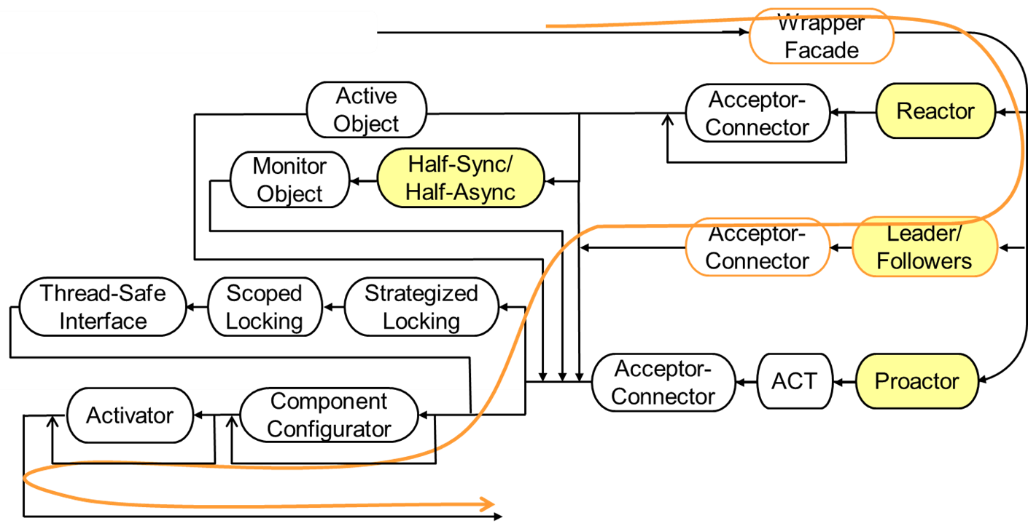
Topics Covered in this Part of the Module
Describe the Active Object pattern
Describe the ACE Task framework
Apply ACE Task & Acceptor-Connector
Describe the Half-Sync/Half-Async pattern
Implement Half-Sync/Half-Async using ACE frameworks
Describe the Monitor Object pattern
Applying Monitor Object & other synchronization patterns
Describe the Leader/ Followers pattern
Apply ACE_TP_Reactor part of Reactor framework to JAWS
A predictable multi-threaded path thru JAWS pattern language

Slide 178
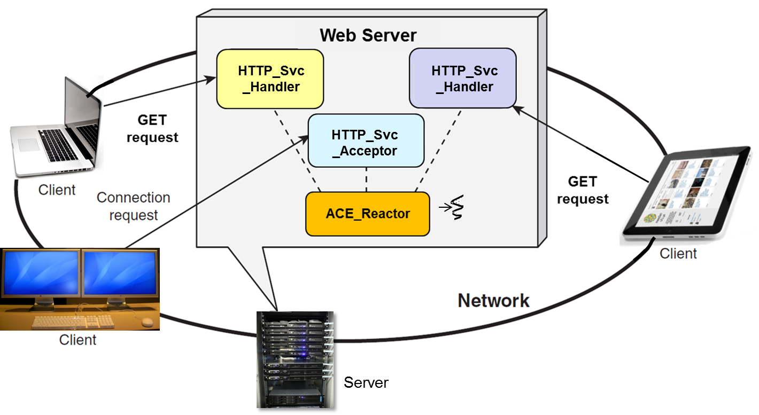
Motivation for the ACE_TP_Reactor Class
Although the ACE Reactor ACE_Select_Reactor is flexible, it's limited for multi-threaded apps since only its owner thread can call run_event_loop()
Just a single thread

Slide 179
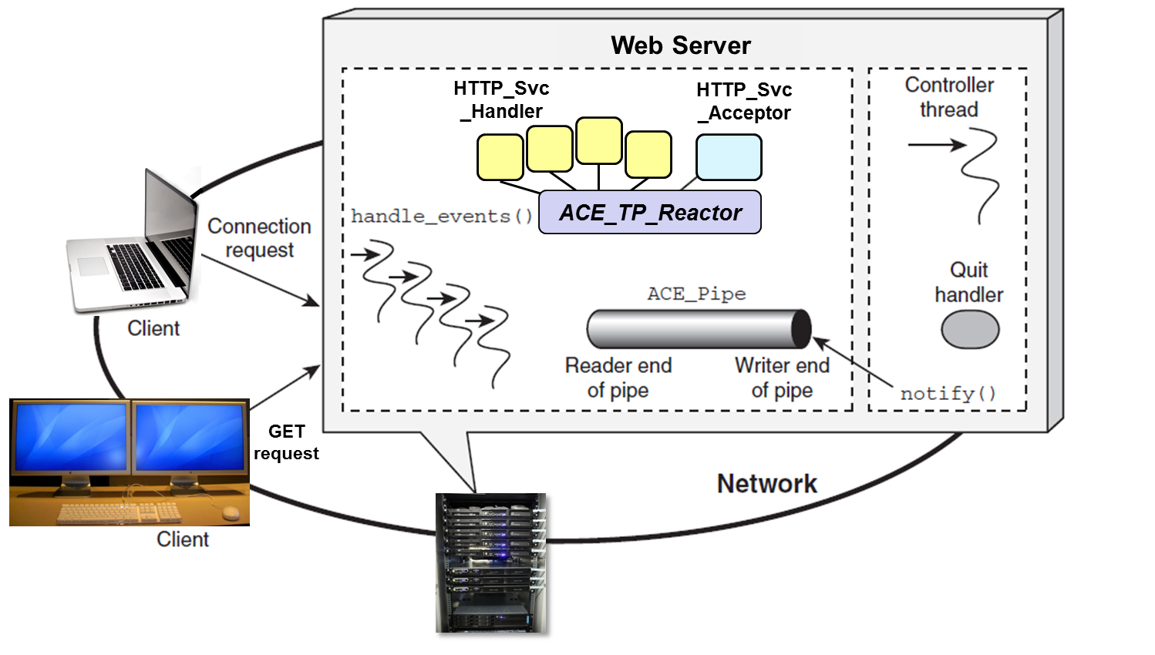
Motivation for the ACE_TP_Reactor Class
Although the ACE Reactor ACE_Select_Reactor is flexible, it's limited for multi-threaded apps since only its owner thread can call run_event_loop()
The ACE_TP_Reactor implements the Leader/ Followers pattern
Enables the use of ACE Reactor framework in more scalable multi-threaded configurations
run_event_loop()
A pool of threads

Slide 180
The ACE_TP_Reactor Class
Inherits from ACE_Select_Reactor, implements ACE_Reactor interface, & applies the Leader/Followers pattern to provide the following capabilities:
A pool of threads can call its run_event_loop() method
Improves scalability by handling events on multiple handles concurrently
demultiplexes
Thread Pool
synchronizer
join()
promote_new_leader()
*
ACE_Event_Handler
ACE_Handle
uses
handle_input ()
get_handle()
*
ACE_TP_Reactor
Concrete Event
Handler
run_event_loop()
deacitivate_handle()
reactivate_handle()
select()
handle_input ()
get_handle()

Slide 181
The ACE_TP_Reactor Class
Inherits from ACE_Select_Reactor, implements ACE_Reactor interface, & applies the Leader/Followers pattern to provide the following capabilities:
A pool of threads can call its run_event_loop() method
Improves scalability by handling events on multiple handles concurrently
Prevents multiple I/O events from being dispatched to same event handler in different threads
Preserves ACE_Select_ Reactor’s I/O dispatching behavior, so there’s no need to add synchronization locks
demultiplexes
Thread Pool
synchronizer
join()
promote_new_leader()
*
ACE_Event_Handler
ACE_Handle
uses
handle_input ()
get_handle()
*
ACE_TP_Reactor
Concrete Event
Handler
run_event_loop()
deacitivate_handle()
reactivate_handle()
select()
handle_input ()
get_handle()
Handles variability of multi-threaded access to select() via a common API

Slide 182
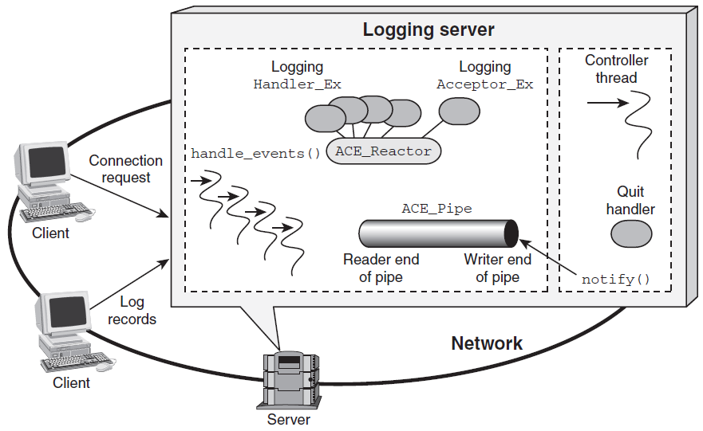
Using the ACE_TP_Reactor Class with JAWS
Extend the ACE Acceptor-Connector JAWS web server example to spawn a pool of threads that share I/O handles
Web Server
HTTP_Svc _Handler
HTTP_Svc _Acceptor
ACE_TP_Reactor
run_event_loop()
GET
request
Server

Slide 183
Using the ACE_TP_Reactor Class with JAWS
1 #include <string>
2 #include <ace/streams.h>
3 #include <ace/Reactor.h>
4 #include <ace/TP_Reactor.h>
5 #include <ace/Thread_Manager.h>
6 #include "Reactor_HTTP_Server.h"
7 void *controller (void *);
8 void *event_loop (void *);
9 typedef Reactor_HTTP_Server<HTTP_Svc_Acceptor>
10 HTTP_Server_Daemon;
Forward declarations
Note reuse of earlier JAWS web server classes

Slide 184
Using the ACE_TP_Reactor Class
13 int main (int argc, char *argv[]) {
14 const size_t THREAD_POOL_SIZE = 8;
ACE_TP_Reactor tp_reactor;
ACE_Reactor reactor (&tp_reactor);
17 new HTTP_Server_Daemon (argc, argv, &reactor);
18 ACE_Thread_Manager::instance ()->spawn_n
19 (THREAD_POOL_SIZE, event_loop, &reactor);
20 ACE_Thread_Manager::instance ()->spawn
21 (controller, &reactor);
22 return ACE_Thread_Manager::instance ()->wait ();
23 }
Create an ACE_TP_Reactor & associate it with ACE_Reactor
Dynamic allocation ensures proper deletion semantics
Spawn threads to run reactor loop & controller
Barrier synchronization

Slide 185
Using the ACE_TP_Reactor Class
1 static void *event_loop (void *arg) {
2 ACE_Reactor *reactor = static_cast<ACE_Reactor *> (arg);
3 reactor->run_reactor_event_loop ();
4 return 0;
5 }
Run in multiple threads

Slide 186
Using the ACE_TP_Reactor Class
1 static void *event_loop (void *arg) {
2 ACE_Reactor *reactor = static_cast<ACE_Reactor *> (arg);
3 reactor->run_reactor_event_loop ();
4 return 0;
5 }
Run in a separate thread
1 static void *controller (void *arg) {
2 ACE_Reactor *reactor = static_cast<ACE_Reactor *> (arg);
3 Quit_Handler *quit_handler = new Quit_Handler (reactor);
4 for (;;) {
5 std::string user_input;
6 std::getline (cin, user_input, '\n');
7 if (user_input == "quit") {
8 reactor->notify (quit_handler);
9 break;
10 }
11 }
...
Use the Reactor’s notify pipe to wakeup the reactor & inform it to shut down by calling handle_exception()
The single-threaded & multi-threaded Reactor web servers are quite similar

Slide 187
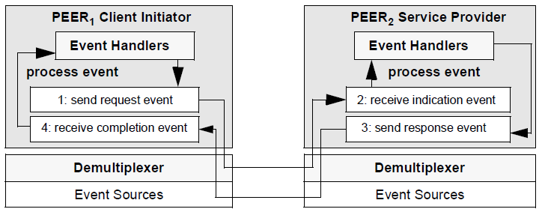
Summary
Different OS concurrency & event (de)muxing mechanisms can present challenges & opportunities
select()
/dev/epoll
WaitForMultipleObjects()
poll()
/dev/poll

Slide 188
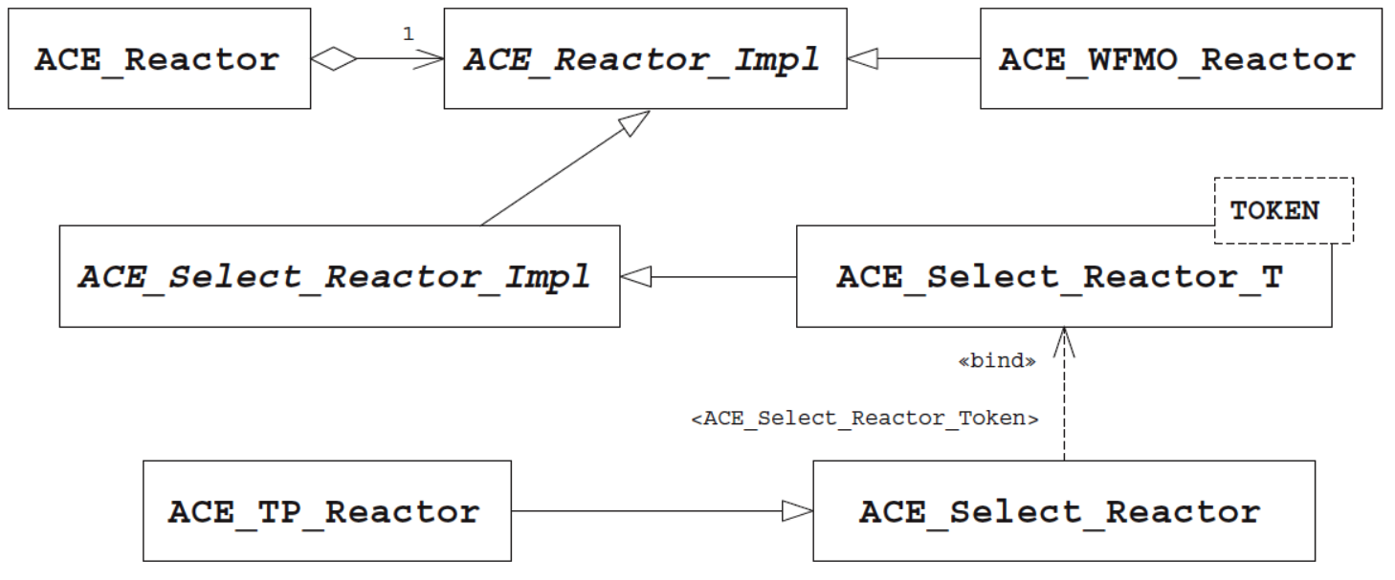
Summary
Different OS concurrency & event (de)muxing mechanisms can present challenges & opportunities
ACE frameworks can use OS concurrency & event (de)muxing capabilities effectively
Complex design issues are isolated in the ACE Reactor framework, rather than in app code

Slide 189
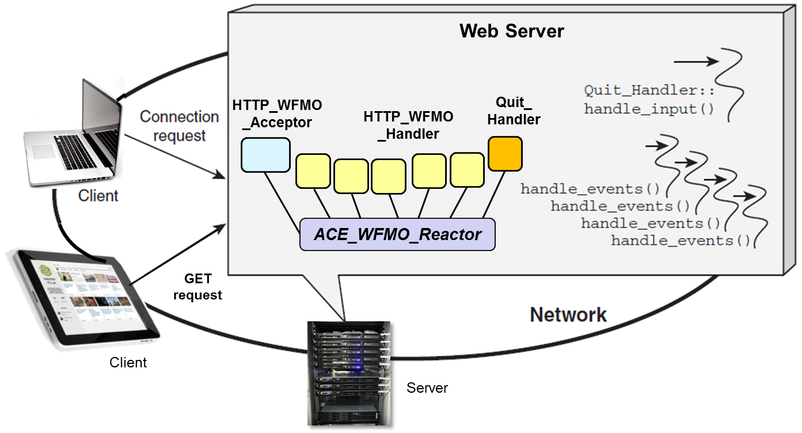
Summary
Different OS concurrency & event (de)muxing mechanisms can present challenges & opportunities
ACE frameworks can use OS concurrency & event (de)muxing capabilities effectively
Complex design issues are isolated in the ACE Reactor framework, rather than in app code
ACE_WFMO_Reactor provides similar thread pool capabilities for Windows platforms

